Slide 1
TROP-2 & HER2 expression and response in TROPiCS-02
Disease: metastatic HR+/HER2-
Drug: Trodelvy▼ (sacituzumab govitecan)
Category: Phase III
Treatment line: 3L and beyond
Presenter: Bardia
Congress: ASCO 2023
SE-TRO-0138 Date of preparation April 2024
▼Detta läkemedel är föremål för utökad övervakning.

Slide 2
Trop-2 mRNA Expression and Association With Clinical Outcomes With Sacituzumab Govitecan (SG) in Patients With HR+/HER2‒ Metastatic Breast Cancer (mBC): Biomarker Results From the Phase 3 TROPiCS-02 Study
Aditya Bardia,¹ Hope S. Rugo,² Javier Cortes,³ Sara Tolaney,⁴ Peter Schmid,⁵ Monica Motwani,⁶ Oh Kyu Yoon,⁶ Jillian Boice,⁶ Luting Zhuo,⁶ Frederik Marmé⁷
¹Medical Oncology, Massachusetts General Hospital Cancer Center, Harvard Medical School, Boston, MA, USA; ²Department of Medicine, University of California Helen Diller Family Comprehensive Cancer Center, San Francisco, CA, USA; ³Medical Oncology Department, International Breast Cancer Center (IBCC), Pangaea Oncology, Madrid, Spain; ⁴Department of Medical Oncology, Dana-Farber Cancer Institute, Boston, MA, USA; ⁵Barts Cancer Institute, Queen Mary University of London, London, UK; ⁶Gilead Sciences, Inc., Foster City, CA, USA; ⁷Medical Faculty Mannheim, Heidelberg University, Department of Obstetrics and Gynecology, Mannheim, Germany

Slide 3
Introduction
Breast cancer is the second leading cause of cancer death in women,¹ and hormone receptor-positive (HR+)/human epidermal growth factor-negative (HER2–)a cancers represent approximately 70% of breast cancers²
Sacituzumab govitecan (SG) is a trophoblast cell surface antigen 2 (Trop-2)–directed antibody-drug conjugate (ADC) that has been approved in multiple countries for patients with triple-negative breast cancer after at least 1 prior therapy and in the EU also for patients with pretreated HR+/HER2‒ mBC³
In the phase 3 randomized TROPiCS-02 study, SG versus treatment of physician’s choice (TPC) demonstrated significantly improved median progression-free survival (PFS; 5.5 vs 4.0 months [mo]; hazard ratio [HR], 0.66; P = .0003) and median overall survival (OS; 14.4 vs 11.2 mo; HR, 0.79; P = .020), and a well characterized safety profile in patients with pretreated, endocrine-resistant HR+/HER2– mBC⁴
SG improved PFS and OS regardless of Trop-2 expression by immunohistochemistry (IHC) in a post hoc analysis⁵
  Median PFS with SG versus TPC was 5.3 versus 4.0 mo (HR, 0.77; 95% CI, 0.54-1.09) in patients with H-score < 100, and 6.4 versus 4.1 mo (HR, 0.60; 95% CI, 0.44-0.81) in patients with H-score ≥ 100⁵
  Median OS with SG versus TPC was 14.6 versus 11.3 mo (HR, 0.75; 95% CI, 0.54-1.04) in patients with H-score < 100, and 14.4 versus 11.2 mo (HR, 0.83; 95% CI, 0.62-1.11) in patients with H-score ≥ 100⁵
This post hoc analysis used an orthogonal assay of Trop-2 gene expression (TACSTD2), with wider dynamic range than prior assays, to correlate with efficacy outcomes and other biomarkers
ªIHC 0, IHC 1+, or IHC2+ and in situ hybridization-negative (ISH-).
ADC, antibody-drug conjugate; HER2‒, human epidermal growth factor receptor 2-negative; HR+, hormonal receptor–positive; IHC, immunohistochemistry; mBC, metastatic breast cancer; mo, months; PFS, progression-free survival; OS, overall survival; SG, Sacituzumab govitecan; TPC, treatment of physician’s choice; Trop-2, trophoblast cell surface antigen
1. American Cancer Society. Key Statistics for Breast Cancer. https://www.cancer.org/cancer/breast-cancer/about/how-common-is-breast-cancer.html. Accessed March 15, 2023; 2. American Cancer Society. Female Breast Cancer Subtypes. https://seer.cancer.gov/statfacts/html/breast-subtypes.html. Accessed March 15, 2023; 3. TRODELVY® (sacituzumab govitecan) SmPC.2023/07; 4. Rugo HS, et al. J Clin Oncol. 2022;40:3365-3376; 5. Rugo HS, et al. Oral presentation at San Antonio Breast Cancer Symposium (SABCS); December 6-10, 2022; San Antonio, TX, USA. Abstract GS1-11; 6. Bardia A, et al. Trop-2 mRNA Expression and Association With Clinical Outcomes With Sacituzumab Govitecan (SG) in Patients With HR+/HER2‒ Metastatic Breast Cancer (mBC): Biomarker Results From the Phase 3 TROPiCS-02 Study. Presented at ASCO 2023 Abstract #1082.
3
Notes:
MAIN MESSAGE:
This post hoc analysis used an orthogonal assay of Trop-2 gene expression (TACSTD2), with wider dynamic range than prior assays, to correlate with efficacy outcomes and other biomarkers
KEY POINTS:
Breast cancer is the second leading cause of cancer death in women, and hormone receptor-positive (HR+)/human epidermal growth factor-negative (HER2–)a cancers represent approximately 70% of breast cancers
Sacituzumab govitecan (SG) is a trophoblast cell surface antigen 2 (Trop-2)–directed antibody-drug conjugate (ADC) that has been approved in multiple countries for patients with triple-negative breast cancer after at least 1 prior therapy and in the US also for patients with pretreated HR+/HER2‒ mBC
In the phase 3 randomized TROPiCS-02 study, SG versus treatment of physician’s choice (TPC) demonstrated significantly improved median progression-free survival (PFS; 5.5 vs 4.0 months [mo]; hazard ratio [HR], 0.66; P = .0003) and median overall survival (OS; 14.4 vs 11.2 mo; HR, 0.79; P = .020), and a well characterized safety profile in patients with pretreated, endocrine-resistant HR+/HER2– mBC
SG improved PFS and OS regardless of Trop-2 expression by immunohistochemistry (IHC) in a post hoc analysis
Median PFS with SG versus TPC was 5.3 versus 4.0 mo (HR, 0.77; 95% CI, 0.54-1.09) in patients with H-score < 100, and 6.4 versus 4.1 mo (HR, 0.60; 95% CI, 0.44-0.81) in patients with H-score ≥ 100
Median OS with SG versus TPC was 14.6 versus 11.3 mo (HR, 0.75; 95% CI, 0.54-1.04) in patients with H-score < 100, and 14.4 versus 11.2 mo (HR, 0.83; 95% CI, 0.62-1.11) in patients with H-score ≥ 100
REFERENCES:
American Cancer Society. Key Statistics for Breast Cancer. https://www.cancer.org/cancer/breast-cancer/about/how-common-is-breast-cancer.html. Accessed March 15, 2023;
American Cancer Society. Female Breast Cancer Subtypes. https://seer.cancer.gov/statfacts/html/breast-subtypes.html. Accessed March 15, 2023;
TRODELVY® (sacituzumab govitecan-hziy) [package insert]. Foster City, CA: Gilead Sciences, Inc.; March 2023;
Rugo HS, et al. J Clin Oncol. 2022;40:3365-3376;
Rugo HS, et al. Oral presentation at San Antonio Breast Cancer Symposium (SABCS); December 6-10, 2022; San Antonio, TX, USA. Abstract GS1-11.
Bardia A, et al. Trop-2 mRNA Expression and Association With Clinical Outcomes With Sacituzumab Govitecan (SG) in Patients With HR+/HER2‒ Metastatic Breast Cancer (mBC): Biomarker Results From the Phase 3 TROPiCS-02 Study. Presented at ASCO 2023 Abstract #1082.
ABBREVIATIONS:
ADC, antibody-drug conjugate; HER2‒, human epidermal growth factor receptor 2-negative; HR+, hormonal receptor–positive; IHC, immunohistochemistry; mBC, metastatic breast cancer; mo, months; PFS, progression-free survival; OS, overall survival; SG, Sacituzumab govitecan; TPC, treatment of physician’s choice; Trop-2, trophoblast cell surface antigen 2.

Slide 4
Methods
TROPiCS-02 is a randomized, open-label, phase 3 study of SG, a first-in-class Trop-2–directed ADC consisting of a humanized anti-Trop-2 monoclonal antibody conjugated to an active metabolite of irinotecan (SN-38) via a hydrolysable CL2A linker¹
Archival formalin-fixed paraffin-embedded primary or metastatic tumor tissue samples were collected at the start of the study. The samples were scraped from slides for RNA extraction; samples with less than 50% viable tumors were macro-dissected. RNA was isolated from the samples, and libraries were prepared with TruSeq RNA Exome Prep Kit (Illumina) and sequenced with an Illumina NovaSeq Sequencer (2 × 150bp)
  RNAseq data were available from 197 tumor samples in the intent-to-treat (ITT) population (36% of ITT)
  Gene expression was quantitated using Salmon²
TACSTD2 low and high mRNA expression were defined as expression below the median (10.5 transcripts per million [TPM]) and above the median, respectively
Membrane Trop-2 expression was determined using a fit-for-purpose validated IHC research assay at a College of American Pathologists/Clinical Laboratory Improvement Amendments central laboratory
  H-score was calculated (0-300), representing the sum of percent staining weighted by staining intensity
  Trop-2 H-score cutoffs were set at < 100 and ≥ 100³
Local IHC and in situ hybridization (ISH) results were utilized for HER2 status determination
  HER2-low status was defined as an IHC score of 1+, or 2+ with negative ISH result
  HER2 IHC0 status was defined as an IHC score of 0
ADC, antibody-drug conjugate; HER2‒, human epidermal growth factor receptor 2-negative; IHC, immunohistochemistry; ISH, in situ hybridization; ITT, intent-to-treat; SG, Sacituzumab govitecan; TPC, treatment of physician’s choice; Trop-2, trophoblast cell surface antigen 2.
1. Rugo HS, et al. J Clin Oncol. 2022;40:3365-3376; 2. Patro R, et al. Nat Methods. 2017;14:417-419; 3. Rugo HS, et al. Oral presentation at San Antonio Breast Cancer Symposium (SABCS); December 6-10, 2022; San Antonio, TX, USA. Abstract GS1-11; 4. Bardia A, et al. Trop-2 mRNA Expression and Association With Clinical Outcomes With Sacituzumab Govitecan (SG) in Patients With HR+/HER2‒ Metastatic Breast Cancer (mBC): Biomarker Results From the Phase 3 TROPiCS-02 Study. Presented at ASCO 2023 Abstract #1082.
4
Notes:
MAIN MESSAGE:
Methods used in this post-hoc analysis are described
KEY POINTS:
TROPiCS-02 is a randomized, open-label, phase 3 study of SG, a first-in-class Trop-2–directed ADC consisting of a humanized anti-Trop-2 monoclonal antibody conjugated to an active metabolite of irinotecan (SN-38) via a hydrolysable CL2A linker1
Archival formalin-fixed paraffin-embedded primary or metastatic tumor tissue samples were collected at the start of the study. The samples were scraped from slides for RNA extraction; samples with less than 50% viable tumors were macro-dissected. RNA was isolated from the samples, and libraries were prepared with TruSeq RNA Exome Prep Kit (Illumina) and sequenced with an Illumina NovaSeq Sequencer (2  150bp)
RNAseq data were available from 197 tumor samples in the intent-to-treat (ITT) population (36% of ITT)
Gene expression was quantitated using Salmon2
TACSTD2 low and high mRNA expression were defined as expression below the median (10.5 transcripts per million [TPM]) and above the median, respectively
Membrane Trop-2 expression was determined using a fit-for-purpose validated IHC research assay at a College of American Pathologists/Clinical Laboratory Improvement Amendments central laboratory
H-score was calculated (0-300), representing the sum of percent staining weighted by staining intensity
Trop-2 H-score cutoffs were set at < 100 and ≥ 1003
Local IHC and in situ hybridization (ISH) results were utilized for HER2 status determination
HER2-low status was defined as an IHC score of 1+, or 2+ with negative ISH result
HER2 IHC0 status was defined as an IHC score of 0
REFERENCES:
Rugo HS, et al. J Clin Oncol. 2022;40:3365-3376;
Patro R, et al. Nat Methods. 2017;14:417-419;
Rugo HS, et al. Oral presentation at San Antonio Breast Cancer Symposium (SABCS); December 6-10, 2022; San Antonio, TX, USA. Abstract GS1-11.
Bardia A, et al. Trop-2 mRNA Expression and Association With Clinical Outcomes With Sacituzumab Govitecan (SG) in Patients With HR+/HER2‒ Metastatic Breast Cancer (mBC): Biomarker Results From the Phase 3 TROPiCS-02 Study. ASCO Abstract #1082.
ABBREVIATIONS:
ADC, antibody-drug conjugate; HER2‒, human epidermal growth factor receptor 2-negative; IHC, immunohistochemistry; ISH, in situ hybridization; ITT, intent-to-treat; SG, Sacituzumab govitecan; TPC, treatment of physician’s choice; Trop-2, trophoblast cell surface antigen 2.

Slide 5
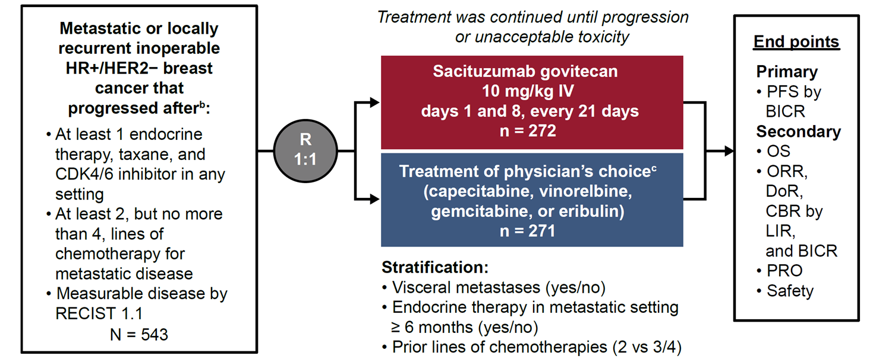
TROPiCS-02: A phase 3 study of SG in HR+/HER2– locally recurrent inoperable or metastatic breast cancerª
BICR, Blinded Independent Central Review; BMI, body mass index; CBR, clinical benefit rate; CDK, cyclin-dependent kinase; DoR, duration of response; ECOG PS, Eastern Cooperative Oncology Group performance status; IQR, interquartile range; ITT, intent-to-treat; LIR, local investigator review; PFS, progression-free survival; OS, overall survival; ORR, objective response rate; SG, sacituzumab govitecan; TPC, treatment of physician’s choice; PRO, patient reported outcomes; R, randomized; RECIST, Response Evaluation Criteria in Solid Tumors.
ªPercentages may not add up to 100 due to rounding.
1. Bardia A, et al. Trop-2 mRNA Expression and Association With Clinical Outcomes With Sacituzumab Govitecan (SG) in Patients With HR+/HER2‒ Metastatic Breast Cancer (mBC): Biomarker Results From the Phase 3 TROPiCS-02 Study. Presented at ASCO 2023 Abstract #1082.
5
Notes:
MAIN MESSAGE:
TROPiCS-02 study design
KEY POINTS:
As seen on slide
REFERENCES:
Bardia A, et al. Trop-2 mRNA Expression and Association With Clinical Outcomes With Sacituzumab Govitecan (SG) in Patients With HR+/HER2‒ Metastatic Breast Cancer (mBC): Biomarker Results From the Phase 3 TROPiCS-02 Study. Presented at ASCO 2023 Abstract #1082.
ABBREVIATIONS:
BICR, Blinded Independent Central Review; BMI, body mass index; CBR, clinical benefit rate; CDK, cyclin-dependent kinase; DoR, duration of response; ECOG PS, Eastern Cooperative Oncology Group performance status; IQR, interquartile range; ITT, intent-to-treat; LIR, local investigator review; PFS, progression-free survival; OS, overall survival; ORR, objective response rate; SG, sacituzumab govitecan; TPC, treatment of physician’s choice; PRO, patient reported outcomes; R, randomized; RECIST, Response Evaluation Criteria in Solid Tumors.

Slide 6
Demographics and baseline characteristics
Baseline characteristics were generally consistent between patients evaluable for TACSTD2 expression and the ITT population
 | ITT |  | TACSTD2 expression |  | TACSTD2 < 10.5 TPM |  | TACSTD2 ≥ 10.5 TPM
 | SG (n = 272) | TPC (n = 271) | SG (n = 100) | TPC (n = 97) | SG (n = 47) | TPC (n = 51) | SG (n = 53) | TPC (n = 46)
Female, n (%) | 270 (99) | 268 (99) | 100 (100) | 96 (99) | 47 (100) | 50 (98) | 53 (100) | 46 (100)
Median age, (IQR) y | 57 (49-65) | 55 (48-63) | 59 (50-65) | 54 (47-63) | 58 (50-64) | 56 (50-63) | 59 (51-66) | 53 (44-65)
Median baseline BMI, (IQR) kg/m² | 25 (22-29) | 24 (21-29) | 26 (23-29) | 23 (21-29) | 26 (23-27) | 25 (22-29) | 26 (23-31) | 22 (20-26)
Race or ethnic group, n (%)ª
White | 184 (68) | 178 (66) | 62 (62) | 65 (67) | 31 (66) | 32 (63) | 31 (58) | 33 (72)
Non-white | 19 (7) | 23 (8) | 9 (9) | 10 (10) | 7 (15) | 6 (12) | 2 (4) | 4 (9)
Not reported | 69 (25) | 70 (26) | 29 (29) | 22 (23) | 9 (19) | 13 (25) | 20 (38) | 9 (20)
ECOG PS, n %
0 | 116 (43) | 126 (46) | 45 (45) | 52 (54) | 26 (55) | 27 (53) | 19 (36) | 25 (54)
1 | 156 (57) | 145 (54) | 55 (55) | 45 (46) | 21 (45) | 24 (47) | 34 (64) | 21 (46)
Lines of prior chemotherapy, n (%)
2 | 113 (42) | 113 (42) | 42 (42) | 41 (42) | 21 (45) | 20 (39) | 21 (40) | 21 (46)
3/4 | 159 (58) | 158 (58) | 58 (58) | 56 (58) | 26 (55) | 31 (61) | 32 (60) | 25 (54)
Prior CDK4/6 inhibitor use, n (%)
≤ 12 months | 161 (60) | 166 (62) | 62 (63) | 62 (65) | 23 (51) | 35 (71) | 39 (74) | 27 (59)
> 12 months | 106 (40) | 102 (38) | 36 (37) | 33 (35) | 22 (49) | 14 (29) | 14 (26) | 19 (41)
Unknown | 5 | 3 | 2 | 2 | 2 | 2 | 0 | 0
BMI, body mass index; CDK, cyclin-dependent kinase; ECOG PS, Eastern Cooperative Oncology Group performance status; IQR, interquartile range; ITT, intent-to-treat; SG, sacituzumab govitecan; TPC, treatment of physician’s choice.
1. Bardia A, et al. Trop-2 mRNA Expression and Association With Clinical Outcomes With Sacituzumab Govitecan (SG) in Patients With HR+/HER2‒ Metastatic Breast Cancer (mBC): Biomarker Results From the Phase 3 TROPiCS-02 Study. Presented at ASCO 2023 Abstract #1082.
6
Notes:
MAIN MESSAGE:
Baseline characteristics were generally consistent between patients evaluable for TACSTD2 expression and the ITT population¹
KEY POINTS:
As seen on slide
REFERENCES:
Bardia A, et al. Trop-2 mRNA Expression and Association With Clinical Outcomes With Sacituzumab Govitecan (SG) in Patients With HR+/HER2‒ Metastatic Breast Cancer (mBC): Biomarker Results From the Phase 3 TROPiCS-02 Study. Presented at ASCO 2023 Abstract #1082.
ABBREVIATIONS:
BMI, body mass index; CDK, cyclin-dependent kinase; ECOG PS, Eastern Cooperative Oncology Group performance status; IQR, interquartile range; ITT, intent-to-treat; SG, sacituzumab govitecan; TPC, treatment of physician’s choice.

Slide 7
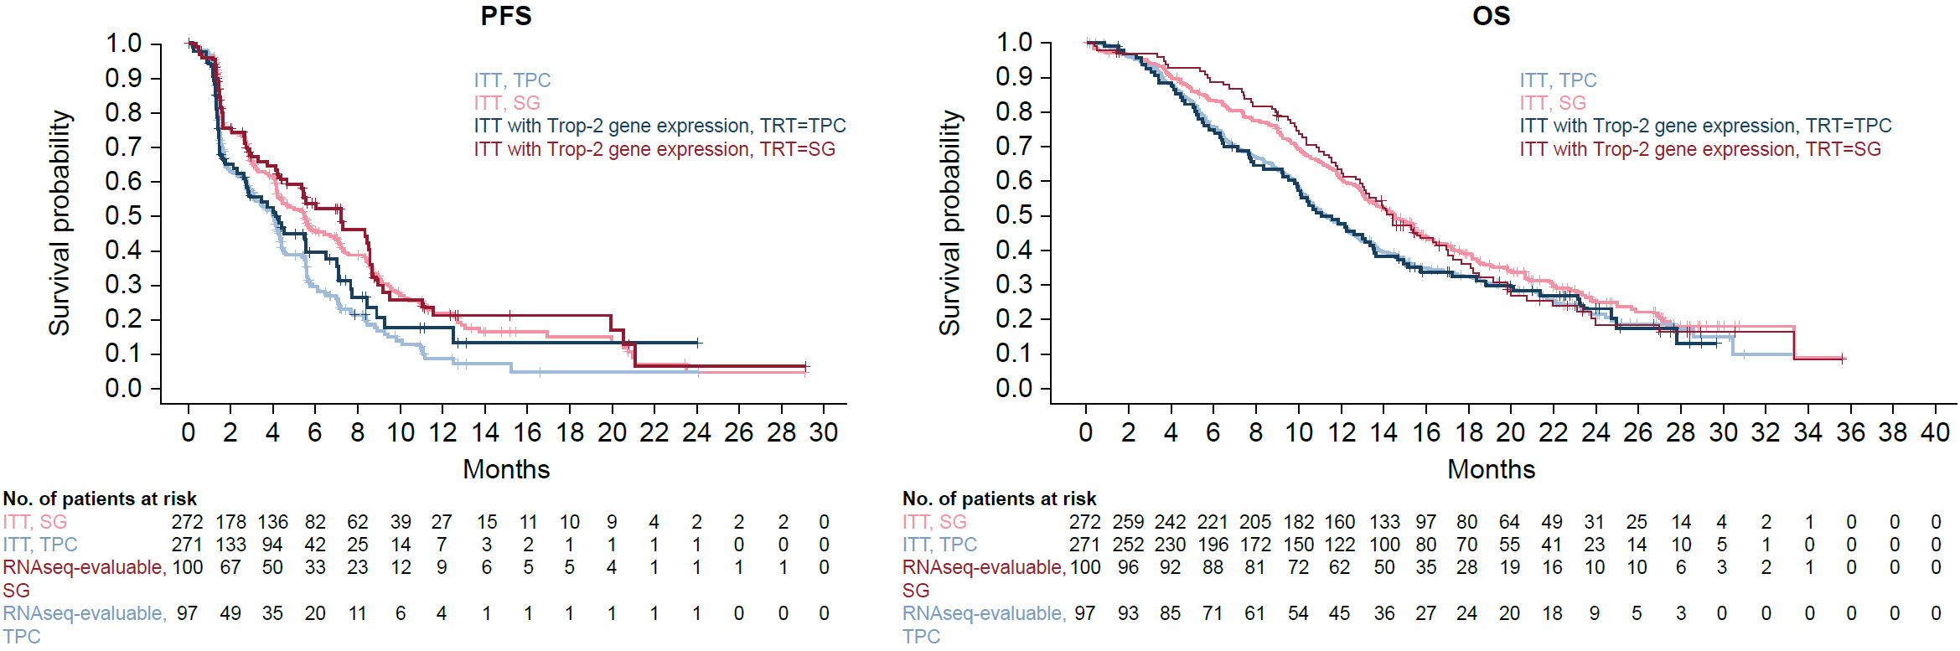
PFS and OS in the ITT and RNAseq-evaluable populations
PFS and OS were comparable in the ITT population and in the RNAseq-evaluable population
ITT, intent-to-treat; OS, overall survival; PFS, progression-free survival; SG, sacituzumab govitecan; TPC, treatment of physician’s choice.
1. Bardia A, et al. Trop-2 mRNA Expression and Association With Clinical Outcomes With Sacituzumab Govitecan (SG) in Patients With HR+/HER2‒ Metastatic Breast Cancer (mBC): Biomarker Results From the Phase 3 TROPiCS-02 Study. Presented at ASCO 2023 Abstract #1082.
7
Notes:
MAIN MESSAGE:
PFS and OS were comparable in the ITT population and in the RNAseq-evaluable population
KEY POINTS:
As seen on slide
REFERENCES:
Bardia A, et al. Trop-2 mRNA Expression and Association With Clinical Outcomes With Sacituzumab Govitecan (SG) in Patients With HR+/HER2‒ Metastatic Breast Cancer (mBC): Biomarker Results From the Phase 3 TROPiCS-02 Study. Presented at ASCO 2023 Abstract #1082.
ABBREVIATIONS:
ITT, intent-to-treat; OS, overall survival; PFS, progression-free survival; SG, sacituzumab govitecan; TPC, treatment of physician’s choice.

Slide 8
Concordance scores between TACSTD2 mRNA expression and Trop-2 IHC
Moderate positive concordance was observed between TACSTD2 mRNA expression (median 10.5 TPM) and Trop-2 IHC (median H-score 115)
Concordance by H-score was 71% (Cohen’s kappa = 0.41)
Total (N = 194) |  | TACSTD2 mRNA
 |  | Below median | Above median
Trop-2 IHC H-score | Below median | 71 | 33
 | Above median | 24 | 66
IHC, immunohistochemistry; Trop-2, trophoblast cell surface antigen 2.
1. Bardia A, et al. Trop-2 mRNA Expression and Association With Clinical Outcomes With Sacituzumab Govitecan (SG) in Patients With HR+/HER2‒ Metastatic Breast Cancer (mBC): Biomarker Results From the Phase 3 TROPiCS-02 Study. Presented at ASCO 2023 Abstract #1082.
8
Notes:
MAIN MESSAGE:
Moderate positive concordance was observed between TACSTD2 mRNA expression (median 10.5 TPM) and Trop-2 IHC (median H-score 115)
Concordance by H-score was 71% (Cohen’s kappa = 0.41)
KEY POINTS:
As seen on slide
REFERENCES:
Bardia A, et al. Trop-2 mRNA Expression and Association With Clinical Outcomes With Sacituzumab Govitecan (SG) in Patients With HR+/HER2‒ Metastatic Breast Cancer (mBC): Biomarker Results From the Phase 3 TROPiCS-02 Study. Presented at ASCO 2023 Abstract #1082.
ABBREVIATIONS:
IHC, immunohistochemistry; Trop-2, trophoblast cell surface antigen 2.

Slide 9
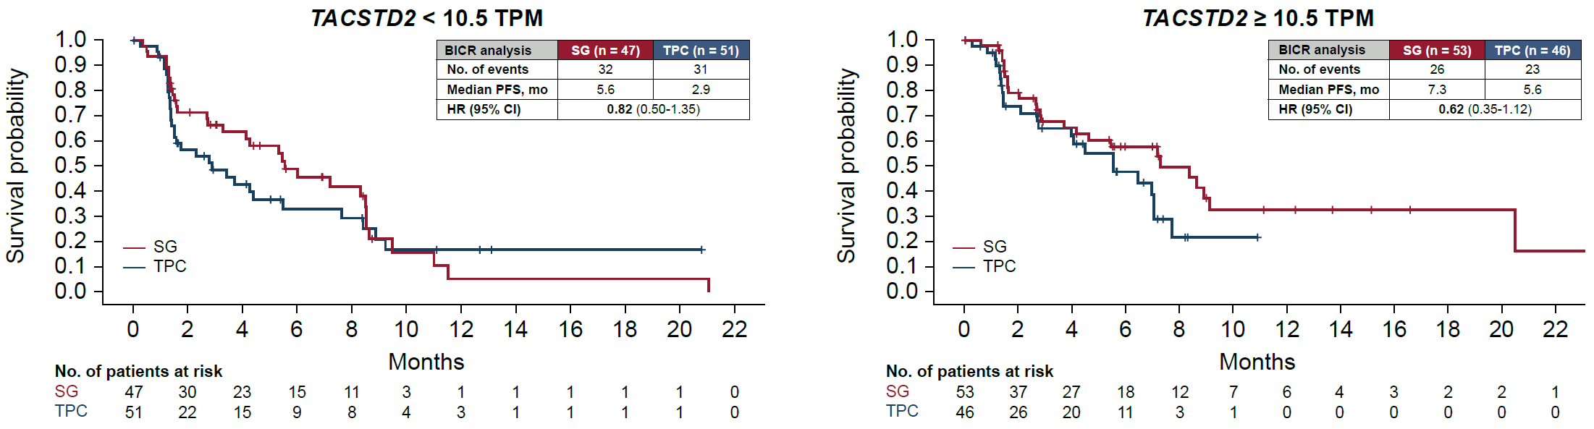
PFS by TACSTD2 mRNA expression
PFS favored SG over TPC regardless of TACSTD2 mRNA expression
BICR, blinded independent central review; HR, hazard ratio; H-score, histogram score; IHC, immunohistochemistry; ITT, intent-to-treat; mo, months; PFS, progression-free survival; SG, sacituzumab govitecan; TPC, treatment of physician’s choice.
1. Bardia A, et al. Trop-2 mRNA Expression and Association With Clinical Outcomes With Sacituzumab Govitecan (SG) in Patients With HR+/HER2‒ Metastatic Breast Cancer (mBC): Biomarker Results From the Phase 3 TROPiCS-02 Study. Presented at ASCO 2023 Abstract #1082.
9
Notes:
MAIN MESSAGE:
PFS favored SG over TPC regardless of TACSTD2 mRNA expression
KEY POINTS:
As seen on slide
REFERENCES:
Bardia A, et al. Trop-2 mRNA Expression and Association With Clinical Outcomes With Sacituzumab Govitecan (SG) in Patients With HR+/HER2‒ Metastatic Breast Cancer (mBC): Biomarker Results From the Phase 3 TROPiCS-02 Study. Presented at ASCO 2023 Abstract #1082.
ABBREVIATIONS:
BICR, blinded independent central review; HR, hazard ratio; H-score, histogram score; IHC, immunohistochemistry; ITT, intent-to-treat; mo, months; PFS, progression-free survival; SG, sacituzumab govitecan; TPC, treatment of physician’s choice.

Slide 10
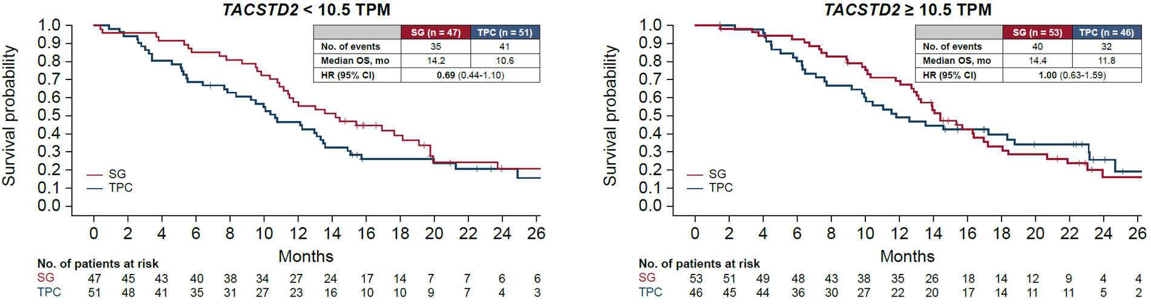
OS by TACSTD2 mRNA expression
Median OS favored SG over TPC regardless of TACSTD2 mRNA expression despite the smaller sample size (36% of the ITT population) compared with prior Trop-2 IHC correlative analyses with H-score < 100 and ≥ 100²
ITT, intent-to-treat; OS, overall survival; SG, sacituzumab govitecan; TPC, treatment of physician’s choice.
1. Bardia A, et al. Trop-2 mRNA Expression and Association With Clinical Outcomes With Sacituzumab Govitecan (SG) in Patients With HR+/HER2‒ Metastatic Breast Cancer (mBC): Biomarker Results From the Phase 3 TROPiCS-02 Study. Presented at ASCO 2023 Abstract #1082; 2. Rugo HS, et al. Oral presentation at San Antonio Breast Cancer Symposium (SABCS); December 6-10, 2022; San Antonio, TX, USA. Abstract GS1-11.
10
Notes:
MAIN MESSAGE:
Median OS favored SG over TPC regardless of TACSTD2 mRNA expression despite the smaller sample size (36% of the ITT population) compared with prior Trop-2 IHC correlative analyses with H-score < 100 and ≥ 1001 (Figure 4)
KEY POINTS:
As seen on slide
REFERENCES:
Bardia A, et al. Trop-2 mRNA Expression and Association With Clinical Outcomes With Sacituzumab Govitecan (SG) in Patients With HR+/HER2‒ Metastatic Breast Cancer (mBC): Biomarker Results From the Phase 3 TROPiCS-02 Study. Presented at ASCO 2023 Abstract #1082.
Rugo HS, et al. Oral presentation at San Antonio Breast Cancer Symposium (SABCS); December 6-10, 2022; San Antonio, TX, USA. Abstract GS1-11.
ABBREVIATIONS:
ITT, intent-to-treat; OS, overall survival; SG, sacituzumab govitecan; TPC, treatment of physician’s choice.

Slide 11
Responses by TACSTD2 mRNA expression
SG versus TPC exhibited improvement of objective response rate (ORR) in the TACSTD2 < 10.5 TPM (odds ratio [OR], 1.27 [95% CI, 0.45-3.63) and ≥ 10.5 TPM subgroups (OR, 2.75 [95% CI, 0.81-9.33]), and ORR in these subgroups was comparable to the ORR observed in the ITT population²
CBR and median duration of response (DoR) were improved with SG versus TPC in the ITT population² and in the TACSTD2 < 10.5 TPM and ≥ 10.5 TPM subgroups
BICR analysis | ITT² |  | TACSTD2 < 10.5 TPM |  | TACSTD2 ≥ 10.5 TPM
 | SG (n = 272) | TPC (n = 271) | SG (n = 47) | TPC (n = 51) | SG (n = 53) | TPC (n = 46)
Best overall response, n (%) | 57 (21) | 38 (14) | 9 (19) | 8 (16) | 11 (21) | 4 (9)
Odds ratio (95% CI) | 1.63 (1.03-2.56) |  | 1.27 (0.45-3.63) |  | 2.75 (0.81-9.33)
Best overall response, n (%)
CR | 2 (1) | 0 | 1 (2) | 0 | 0 | 0
PR | 55 (20) | 38 (14) | 8 (17) | 8 (16) | 11 (21) | 4 (9)
SD | 142 (52) | 106 (39) | 25 (53) | 16 (31) | 29 (55) | 25 (54)
SD ≥ 6 mo | 35 (13) | 22 (8) | 7 (15) | 2 (4) | 9 (17) | 7 (15)
PD | 58 (21) | 76 (28) | 11 (23) | 16 (31) | 10 (19) | 10 (22)
NE | 15 (6) | 51 (19) | 2 (4) | 11 (22) | 3 (6) | 7 (15)
CBR,ª n (%) | 92 (34) | 60 (22) | 16 (34) | 10 (20) | 20 (38) | 11 (24)
Odds ratio (95% CI) | 1.80 (1.23-2.63) |  | 2.12 (0.85-5.30) |  | 1.93 (0.80-4.63)
Median DoR, mo (95% CI) | 8.1 (6.7-9.1) | 5.6 (3.8-7.9) | 7.4 (2.8-NR) | 6.8 (4.1-NR) | 18.6 (5.8-NR) | 4.3 (4.3-NR)
CBR, clinical benefit rate; CR, complete response; DoR, duration of response; NE, not evaluable; NR, not reached; ORR, objective response rate; PD, progressive disease; PR, partial response; SD, stable disease; SG, sacituzumab govitecan; TPC, treatment of physician’s choice.
ªCBR is defined as the percentage of patients with a confirmed best overall response of CR, PR, and SD ≥ 6 months.
1. Bardia A, et al. Trop-2 mRNA Expression and Association With Clinical Outcomes With Sacituzumab Govitecan (SG) in Patients With HR+/HER2‒ Metastatic Breast Cancer (mBC): Biomarker Results From the Phase 3 TROPiCS-02 Study. Presented at ASCO 2023 Abstract #1082; 2. Rugo HS, et al. Oral presentation at San Antonio Breast Cancer Symposium (SABCS); December 6-10, 2022; San Antonio, TX, USA. Abstract GS1-11.
11
Notes:
MAIN MESSAGE:
SG versus TPC exhibited improvement of objective response rate (ORR) in the TACSTD2 < 10.5 TPM (odds ratio [OR], 1.27 [95% CI, 0.45-3.63) and ≥ 10.5 TPM subgroups (OR, 2.75 [95% CI, 0.81-9.33]), and ORR in these subgroups was comparable to the ORR observed in the ITT population
CBR and median duration of response (DoR) were improved with SG versus TPC in the ITT population and in the TACSTD2 < 10.5 TPM and ≥ 10.5 TPM subgroups
KEY POINTS:
As seen on slide
REFERENCES:
Bardia A, et al. Trop-2 mRNA Expression and Association With Clinical Outcomes With Sacituzumab Govitecan (SG) in Patients With HR+/HER2‒ Metastatic Breast Cancer (mBC): Biomarker Results From the Phase 3 TROPiCS-02 Study. Presented at ASCO 2023 Abstract #1082.
Rugo HS, et al. Oral presentation at San Antonio Breast Cancer Symposium (SABCS); December 6-10, 2022; San Antonio, TX, USA. Abstract GS1-11.
ABBREVIATIONS:
CBR, clinical benefit rate; CR, complete response; DoR, duration of response; NE, not evaluable; NR, not reached; ORR, objective response rate; PD, progressive disease; PR, partial response; SD, stable disease; SG, sacituzumab govitecan; TPC, treatment of physician’s choice.

Slide 12
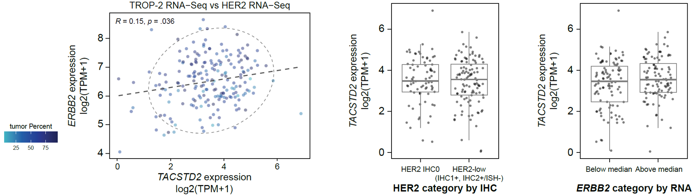
TACSTD2 and HER2 expression
TACSTD2 mRNA expression was not associated with ERBB2 mRNA (HER2 gene) expression
TACSTD2 mRNA expression was similar across HER2 IHC subgroups and ERBB2 mRNA expression
TACSTD2 log2 TPM, HER2 IHC0 3.36 (IQR, 2.76-4.22) and HER2-low (IHC1+, IHC2+/ISH-) 3.44 (IQR, 2.59-4.22)
HER2, human epidermal growth factor receptor 2; IHC, immunohistochemistry; Trop-2, trophoblast cell surface antigen 2.
1. Bardia A, et al. Trop-2 mRNA Expression and Association With Clinical Outcomes With Sacituzumab Govitecan (SG) in Patients With HR+/HER2‒ Metastatic Breast Cancer (mBC): Biomarker Results From the Phase 3 TROPiCS-02 Study. Presented at ASCO 2023 Abstract #1082.
12
Notes:
MAIN MESSAGE:
TACSTD2 mRNA expression was not associated with ERBB2 mRNA (HER2 gene) expression
TACSTD2 mRNA expression was similar across HER2 IHC subgroups and ERBB2 mRNA expression
TACSTD2 log2 TPM, HER2 IHC0 3.36 (IQR, 2.76-4.22) and HER2-low (IHC1+, IHC2+/ISH-) 3.44 (IQR, 2.59-4.22)
KEY POINTS:
As seen on slide
REFERENCES:
Bardia A, et al. Trop-2 mRNA Expression and Association With Clinical Outcomes With Sacituzumab Govitecan (SG) in Patients With HR+/HER2‒ Metastatic Breast Cancer (mBC): Biomarker Results From the Phase 3 TROPiCS-02 Study. Presented at ASCO 2023 Abstract #1082.
ABBREVIATIONS:
HER2, human epidermal growth factor receptor 2; IHC, immunohistochemistry; Trop-2, trophoblast cell surface antigen 2.

Slide 13
PFS and OS by Trop-2 and HER2 IHC subgroupª
Median PFS and OS were higher with SG versus TPC across Trop-2 IHC subgroups for HER2-low (IHC1+, IHC2+/ISH-) and HER2 IHC0 patients, although sample sizes were low
HER2-low (IHC1+, IHC2+/ISH-) | Trop-2 IHC below median |  | Trop-2 IHC above median
 | SG (n = 47) | TPC (n = 45) | SG (n = 82) | TPC (n = 72)
No. of events, PFS | 25 | 25 | 53 | 44
Median PFS, mo (95% CI) | 5.5 (3.1-8.5) | 4.6 (1.7-7.7) | 7.0 (4.0-8.6) | 4.0 (1.7-4.5)
HR (95% CI) | 0.74 (0.42-1.29) |  | 0.47 (0.30-0.73)
No. of events, OS | 33 | 37 | 56 | 50
Median OS, mo (95% CI) | 16.3 (11.5-20.6) | 12.3 (8.7-13.3) | 14.9 (11.6-18.4) | 11.3 (9.5-13.5)
HR (95% CI) | 0.63 (0.39-1.01) |  | 0.80 (0.55-1.18)
HER2 IHC0 | SG (n = 38) | TPC (n = 46) | SG (n = 52) | TPC (n = 44)
No. of events, PFS | 28 | 31 | 30 | 33
Median PFS, mo (95% CI) | 5.0 (3.9-8.5) | 2.8 (1.4-5.4) | 5.6 (2.8-7.5) | 3.4 (1.5-5.6)
HR (95% CI) | 0.77 (0.46-1.29) |  | 0.63 (0.39-1.04)
No. of events, OS | 24 | 34 | 37 | 30
Median OS, mo (95% CI) | 14.6 (10.5-21.9) | 11.0 (8.8-19.5) | 13.6 (11.4-17.0) | 10.4 (6.1-13.6)
HR (95% CI) | 0.86 (0.51-1.46) |  | 0.82 (0.51-1.34)
HER2, human epidermal growth factor receptor 2; IHC, immunohistochemistry; OS, overall survival; PFS, progression-free survival; SG, sacituzumab govitecan; TPC, treatment of physician’s choice; Trop-2, trophoblast cell surface antigen 2.
ªIn patients for whom both Trop-2 IHC and HER2 IHC/ISH data were available.
1. Bardia A, et al. Trop-2 mRNA Expression and Association With Clinical Outcomes With Sacituzumab Govitecan (SG) in Patients With HR+/HER2‒ Metastatic Breast Cancer (mBC): Biomarker Results From the Phase 3 TROPiCS-02 Study. Presented at ASCO 2023 Abstract #1082.
13
Notes:
MAIN MESSAGE:
Median PFS and OS were higher with SG versus TPC across Trop-2 IHC subgroups for HER2-low (IHC1+, IHC2+/ISH-) and HER2 IHC0 patients, although sample sizes were low
KEY POINTS:
As seen on slide
REFERENCES:
Bardia A, et al. Trop-2 mRNA Expression and Association With Clinical Outcomes With Sacituzumab Govitecan (SG) in Patients With HR+/HER2‒ Metastatic Breast Cancer (mBC): Biomarker Results From the Phase 3 TROPiCS-02 Study. Presented at ASCO 2023 Abstract #1082.
ABBREVIATIONS:
HER2, human epidermal growth factor receptor 2; IHC, immunohistochemistry; OS, overall survival; PFS, progression-free survival; SG, sacituzumab govitecan; TPC, treatment of physician’s choice; Trop-2, trophoblast cell surface antigen 2.

Slide 14
Conclusions
SG demonstrated efficacy benefit versus TPC regardless of TACSTD2 mRNA expression
SG should be considered as a therapeutic option in the endocrine-resistant setting, regardless of Trop-2 expression
Similar to the previously published Trop-2 IHC correlative analysis,² SG demonstrated PFS and OS benefit versus TPC regardless of TACSTD2 mRNA expression in patients with pretreated, endocrine-resistant HR+/HER2– mBC
SG benefit with ORR, CBR, and DoR versus TPC was seen regardless of TACSTD2 expression
TACSTD2 expression was not correlated with ERBB2 expression or with HER2 expression by IHC
Regardless of Trop-2 and HER2-negative status, SG improved PFS and OS versus TPC
Additional studies are needed to determine whether TACSTD2 mRNA expression has a prognostic role in mBC
CBR, clinical benefit rate; DoR, duration of response; HER2, human epidermal growth factor receptor 2; HR+, hormonal receptor–positive; IHC, immunohistochemistry; mBC, metastatic breast cancer; ORR, objective response rate; OS, overall survival; PFS, progression-free survival; SG, sacituzumab govitecan; TPC, treatment of physician’s choice; Trop-2, trophoblast cell surface antigen 2.
1. Bardia A, et al. Trop-2 mRNA Expression and Association With Clinical Outcomes With Sacituzumab Govitecan (SG) in Patients With HR+/HER2‒ Metastatic Breast Cancer (mBC): Biomarker Results From the Phase 3 TROPiCS-02 Study. Presented at ASCO 2023 Abstract #1082; 2. Rugo HS, et al. Oral presentation at San Antonio Breast Cancer Symposium (SABCS); December 6-10, 2022; San Antonio, TX, USA. Abstract GS1-11.
14
Notes:
MAIN MESSAGE:
SG demonstrated efficacy benefit versus TPC regardless of TACSTD2 mRNA expression
SG should be considered as a therapeutic option in the endocrine-resistant setting, regardless of Trop-2 expression
KEY POINTS:
Similar to the previously published Trop-2 IHC correlative analysis, SG demonstrated PFS and OS benefit versus TPC regardless of TACSTD2 mRNA expression in patients with pretreated, endocrine-resistant HR+/HER2– mBC
SG benefit with ORR, CBR, and DoR versus TPC was seen regardless of TACSTD2 expression
TACSTD2 expression was not correlated with ERBB2 expression or with HER2 expression by IHC
Regardless of Trop-2 and HER2-negative status, SG improved PFS and OS versus TPC
Additional studies are needed to determine whether TACSTD2 mRNA expression has a prognostic role in mBC
REFERENCES:
Bardia A, et al. Trop-2 mRNA Expression and Association With Clinical Outcomes With Sacituzumab Govitecan (SG) in Patients With HR+/HER2‒ Metastatic Breast Cancer (mBC): Biomarker Results From the Phase 3 TROPiCS-02 Study. Presented at ASCO 2023 Abstract #1082;
Rugo HS, et al. Oral presentation at San Antonio Breast Cancer Symposium (SABCS); December 6-10, 2022; San Antonio, TX, USA. Abstract GS1-11.
ABBREVIATIONS:
CBR, clinical benefit rate; DoR, duration of response; HER2, human epidermal growth factor receptor 2; HR+, hormonal receptor–positive; IHC, immunohistochemistry; mBC, metastatic breast cancer; ORR, objective response rate; OS, overall survival; PFS, progression-free survival; SG, sacituzumab govitecan; TPC, treatment of physician’s choice; Trop-2, trophoblast cell surface antigen 2.

Slide 15
Trodelvy▼ (sacituzumab govitecan)
▼Detta läkemedel är föremål för utökad övervakning.
Trodelvy® (sacituzumabgovitekan) 200 mg pulver till koncentrat till infusionsvätska, lösning. Antineoplastiska medel. Antikropp-läkemedelskonjugat. Rx., EF.
Indikationer: Monoterapi vid behandling av vuxna patienter med icke-resektabel eller metastaserad, trippelnegativ bröstcancer (mTNBC) som tidigare har fått två eller flera systemiska behandlingar, varav minst en av dem mot avancerad sjukdom. Monoterapi vid behandling av vuxna patienter med icke-resektabel eller metastaserad hormonreceptor (HR)-positiv, HER2-negativ bröstcancer som har fått endokrinbaserad behandling och minst två ytterligare systemiska behandlingar för avancerad sjukdom.
Kontraindikationer: Överkänslighet mot sacituzumabgovitekan eller hjälpämne.
Varningar och försiktighet: Kan orsaka svår eller livshotande neutropeni. Det rekommenderas att patienternas blodvärden övervakas under behandlingen. Ska inte administreras om det absoluta antalet neutrofiler understiger 1 500/mm³ på dag 1 under någon cykel eller om antalet neutrofiler understiger 1 000/mm³ på dag 8 under någon cykel eller vid neutropen feber. Kan orsaka svår diarré. Ska inte administreras vid diarré av grad 3–4. Kan orsaka svår eller livshotande överkänslighet. Premedicinering rekommenderas och noggrann observation med avseende på infusionsrelaterade reaktioner. För att förebygga cytostatikainducerat illamående och kräkningar rekommenderas förebyggande behandling med antiemetika. Patienten måste övervakas under varje infusion och i minst 30 minuter efter varje infusion. Patienter med känd reducerad UGT1A1-aktivitet ska övervakas noga med avseende på biverkningar. Gravida kvinnor och fertila kvinnor ska informeras om den potentiella risken för foster. Innehåller natrium, ska beaktas i relation till patientens totala natriumintag.
Innehavare av marknadsföringstillståndet: Gilead Sciences Ireland UC
För information: Kontakta Gilead Sciences Sweden AB, + 46 (0) 8 5057 1849. För fullständig information om dosering, varningar och försiktighet, interaktioner och biverkningar samt aktuell information om förpackningar och priser se www.fass.se
Baserad på produktresumé: 07/2023
SE-TRO-0138 Date of preparation April 2024

