Slide 1
Genomic alterations in DNA damage response (DDR)
genes in TROPiCS-02
Disease: HR+/HER2-
Drug: Trodelvy▼ (sacituzumab govitecan)
Category: Phase III
Treatment line: 3L and beyond
Presenter: Bardia
Congress: ASCO 2024
SE-TRO-0187 Date of preparation Sept 2025
▼Detta läkemedel är föremål för utökad övervakning.

Slide 2
Genomic alterations in DNA damage response (DDR) genes in HR+/HER2- metastatic breast cancer (mBC) and impact on clinical efficacy with Sacituzumab Govitecan (SG): biomarker results from TROPiCS-02 study
Aditya Bardia, MD, MPH;¹ Yi Zhang, PhD;² Frederik Marmé, MD, PhD;³ Peter Schmid, MD, PhD;⁴ Javier Cortés, MD, PhD;⁵ Sara M. Tolaney, MD, MPH;⁶ Yajia Zhang, PhD;² Oh Kyu Yoon, PhD;² Wendy Verret, MPH, PhD;² Meghna Das Thakur, PhD;² Hope S. Rugo, MD⁷
¹University of California Los Angeles, Jonsson Comprehensive Cancer Center, Los Angeles, CA, USA; ²Gilead Sciences, Inc., Foster City, CA, USA; ³ Universitätsmedizin Mannheim, Heidelberg, Germany; ⁴Bart’s Cancer Institute, Queen Mary University of London, London, UK; ⁵International Breast Cancer Center (IBCC), Pangaea Oncology, Quirónsalud Group, Barcelona, Spain & Universidad Europea de Madrid, Madrid, Spain; ⁶Dana-Farber Cancer Institute, Harvard Medical School, Boston, MA, USA; ⁷University of California San Francisco Helen Diller Family Comprehensive Cancer Center, San Francisco, CA, USA
2 June 09:00 AM – 12:00 PM | Hall A
Abstract #1075

Slide 3
Introduction¹⁻⁴
Sacituzumab govitecan (SG) is a Trop-2–directed antibody-drug conjugate coupled to SN-38 as the payload¹
In the phase 3 TROPiCS-02 study (NCT03901339), SG demonstrated clinically meaningful improvement in survival outcomes over chemotherapy in patients with pretreated HR+/HER2– metastatic breast cancer (mBC)²
Median overall survival (OS) was 14.4 months (95% CI, 13.0-15.7) and 11.2 months (10.1-12.7), respectively (hazard ratio [HR], 0.79; 95% CI, 0.65-0.96; P = .020)
SN-38 leads to double-stranded DNA damage; therefore, we hypothesized that in tumors with defective DNA damage response (DDR) machinery, SG may provoke synthetic lethality³
We report on a post hoc exploratory genomic analysis of DDR gene variants in patients from the TROPiCS-02 study and assess SG clinical efficacy by DDR status⁴
1. Starodub AN, et al. Clin Cancer Res. 2015;21:3870-8; 2. Rugo HS, et al. Lancet. 2023;402:1423-33; 3. Goldenberg DM, et al. Expert Opin Biol Ther. 2020;20:871-85; 4. Bardia A et al. ASCO 2024 #1075
Notes:
Key Points:
The poster at ASCO reports on biomarker results based on genomic analysis of DDR gene variants and the impact on SG clinical efficacy in patients with pre-treated HR+/HER2-mBC from the phase 3 TROPiCS-02 study
References:
Starodub AN, et al. Clin Cancer Res. 2015;21:3870-8
Rugo HS, et al. Lancet. 2023;402:1423-33
Goldenberg DM, et al. Expert Opin Biol Ther. 2020;20:871-85
Bardia A, et al. Genomic alterations in DNA damage response (DDR) genes in HR+/HER2- metastatic breast cancer (mBC) and impact on clinical efficacy with Sacituzumab Govitecan (SG): biomarker results from TROPiCS-02 study. Presented at ASCO 2024 Abstract #1075.
Abbreviations:
SG, Sacituzumab govitecan; HR, hormone receptor; HER2-, human epidermal growth factor receptor 2; mBC, metastatic breast cancer; OS, overall survival; HR, hazard ratio; DDR, DNA damage response

Slide 4
1. Bardia A et al. ASCO 2024 #1075 2. Rugo HS, et al. Lancet. 2023;402:1423-33; 3. Kanehisa M, et al. Nucleic Acids Res. 2023;51:D587-92; 4. Human DNA Repair Genes. https://www.mdanderson.org/documents/Labs/Wood-Laboratory/human-dna-repair- genes.html. Accessed April 25, 2024.
Methods¹⁻⁴
Patients with previously treated HR+/HER2– mBC were randomized to receive SG or treatment of physician’s choice (TPC) until disease progression or unacceptable toxicity²
DDR gene deleterious variants were identified using whole exome sequencing (WES) on archival or screening tumor tissues based on 142 DDR pathway genes annotated in the Kyoto Encyclopedia Genes and Genomes (KEGG) database and Human DNA Repair Gene database^{3,4}
The association between DDR deleterious variants and clinical outcomes was evaluated using Cox regression model as HR with 95% CI. Objective response rate (ORR) odds ratio was calculated using the Cochran-Mantel-Haenszel method
Notes:
Key Points:
As per slide
References:
Bardia A, et al. Genomic alterations in DNA damage response (DDR) genes in HR+/HER2- metastatic breast cancer (mBC) and impact on clinical efficacy with Sacituzumab Govitecan (SG): biomarker results from TROPiCS-02 study. Presented at ASCO 2024 Abstract #1075
Rugo HS, et al. Lancet. 2023;402:1423-33;
Kanehisa M, et al. Nucleic Acids Res. 2023;51:D587-92;
Human DNA Repair Genes. https://www.mdanderson.org/documents/Labs/Wood-Laboratory/human-dna-repair- genes.html. Accessed April 25, 2024.
Abbreviations:
SG, Sacituzumab govitecan; HR, hormone receptor; HER2-, human epidermal growth factor receptor 2; mBC, metastatic breast cancer; OS, overall survival; HR, hazard ratio; DDR, DNA damage response; TPC, treatment physician choice; WES, whole exome sequencing; KEGG, Kyoto encyclopedia genes

Slide 5
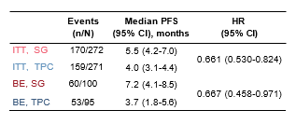
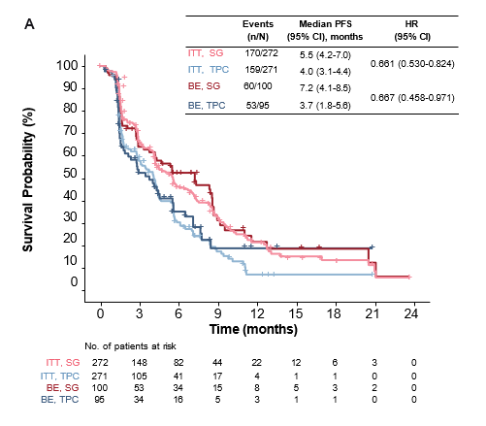
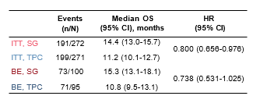
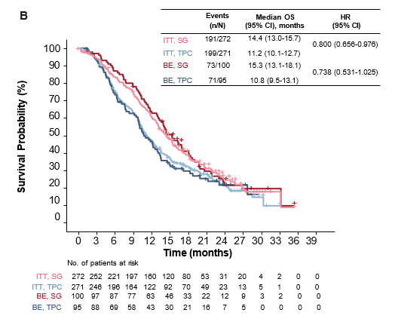
Results¹
Figure 1. PFS (A) and OS (B) in the ITT and BE Population
Of the 543 patients (intent-to-treat [ITT] population, SG, N = 272; TPC, N = 271) enrolled in TROPiCS-02, 195 (36%) patients (SG, n = 100; TPC, n = 95) were included in the WES biomarker evaluable population, which will be referred to as the biomarker evaluable (BE) population hereafter
Overall, demographics and baseline characteristics were similar between the ITT and BE populations (median age, 57 vs 58 years for SG and 55 vs 55 years for TPC; prior lines of chemotherapy > 2 lines, 58% vs 57% for SG and 58% vs 55% for TPC)
A slightly higher proportion of patients with an Eastern Cooperative Oncology Group (ECOG) performance status of 0 (43% vs 48% for SG and 46% vs 51% for TPC) and who had received prior CDK4/6i for less than 12 months (60% vs 65% for SG and 62% vs 67% for TPC) were in the BE population
Progression-free survival (PFS) and OS were similar in the ITT and BE populations and demonstrated improved efficacy with SG vs TPC in these populations (Figure 1)
BE, biomarker-evaluable; HR, hazard ratio; ITT, intent-to-treat; OS, overall survival; PFS, progression-free survival; SG, sacituzumab govitecan; TPC, treatment of physician’s choice.
1. Bardia A et al. ASCO 2024 #1075
Notes:
Key Points:
This exploratory analysis was conducted in 543 patients included in the intent-to-treat (ITT) population in TROPiCS-02 study, out of which whole exome sequencing (WES) data was available for 195 (36%).
Clinicopathological features were similar between ITT and WES dataset (median age = 57 vs 58 for SG and 55 vs 55 for TPC; prior lines of chemotherapy > 2 lines = 59% vs 57% for SG and 58% vs 55% for TPC). Estrogen Receptor (ER) > 10% and prior lines of chemotherapy were comparable between WT and MUT in SG arm and in TPC arm.
Overall, 114 (58%) of tumor samples had ≥1 deleterious alteration.
Although all patients demonstrated improved efficacy with SG vs TPC, patients with DDR mutant MBC had numerically greater benefit in PFS vs WT (MUT HR = 0.61; WT HR = 0.76) and OS (MUT HR = 0.68; WT HR = 0.82).
References:
Bardia A, et al. Genomic alterations in DNA damage response (DDR) genes in HR+/HER2- metastatic breast cancer (mBC) and impact on clinical efficacy with Sacituzumab Govitecan (SG): biomarker results from TROPiCS-02 study. Presented at ASCO 2024 Abstract #1075
Abbreviations:
SG, Sacituzumab govitecan; BE, biomarker evaluable; OS, overall survival; PFS, progression free survival; CDKi, cyclin dependent kinase inhibitor; ITT, intention to treat; HR, hazard ratio; DDR, DNA damage response; TPC, treatment physician choice; WES, whole exome sequencing; KEGG, Kyoto encyclopedia genes

Slide 6
Results¹
Table 1. Demographics and Baseline Characteristics Among Patients With or Without DDR Mutations in the BE Population
Characteristic | SG |  | TPC
 | WT (n =41) | MUT (n =59) | WT (n =40) | MUT (n =55)
Median age (IQR), years | 59 (53-70) | 56 (49-62) | 57 (47-65) | 55 (48-61)
Race, n (%)
White | 26 (63) | 39 (66) | 33 (83) | 33 (60)
Other | 4 (10) | 3 (5) | 0 | 9 (16)
Not reported | 11 (27) | 17 (29) | 7 (17) | 13 (24)
ECOG performance status, n (%)
0 | 20 (49) | 28 (47) | 22 (55) | 26 (47)
1 | 21 (51) | 31 (53) | 18 (45) | 29 (53)
Visceral metastasis, n (%)
Yes | 39 (95) | 55 (93) | 35 (88) | 52 (95)
No | 2 (5) | 4 (7) | 5 (12) | 3 (5)
Prior CDK4/6i treatment duration, n (%)
≤ 12 months | 27 (66) | 37 (65) | 21 (54) | 41 (76)
> 12 months | 14 (34) | 20 (35) | 18 (46) | 13 (24)
ET in the metastatic setting for ≥ 6 months, n (%)
Yes | 36 (88) | 54 (92) | 37 (93) | 48 (87)
No | 5 (12) | 5 (8) | 3 (7) | 7 (13)
Estrogen receptor status, n (%)
> 10% | 39 (95) | 57 (97) | 37 (93) | 47 (85)
Prior CT regimen in the metastatic setting, n (%)
2 | 19 (46) | 24 (41) | 17 (42) | 26 (47)
3-4 | 22 (54) | 35 (59) | 23 (58) | 29 (53)
TPC, n (%)
Capecitabine | - | - | 7 (17) | 1 (2)
Eribulin | - | - | 15 (38) | 24 (44)
Gemcitabine | - | - | 8 (20) | 13 (24)
Vinorelbine | - | - | 10 (25) | 17 (31)
Out of the 195 patients in the BE population, 114 (58%) had at least one DDR gene with a deleterious mutation; baseline characteristics were similar between patients with mutant and wildtype DDR in the SG and TPC arms (Table 1)
1. Bardia A et al. ASCO 2024 #1075
Notes:
Key Points:
Out of the 195 patients in the BE population, 114 (58%) had at least one DDR gene with a deleterious mutation; baseline characteristics were similar between patients with mutant and wildtype DDR in the SG and TPC arms (Table 1)
References:
Bardia A, et al. Genomic alterations in DNA damage response (DDR) genes in HR+/HER2- metastatic breast cancer (mBC) and impact on clinical efficacy with Sacituzumab Govitecan (SG): biomarker results from TROPiCS-02 study. Presented at ASCO 2024 Abstract #1075
Abbreviations:
SG, Sacituzumab govitecan; TPC, treatment physician choice; DDR, DNA damage response; WT, wild type; MUT, mutant; ET, endocrine therapy; CT, chemotherapy

Slide 7
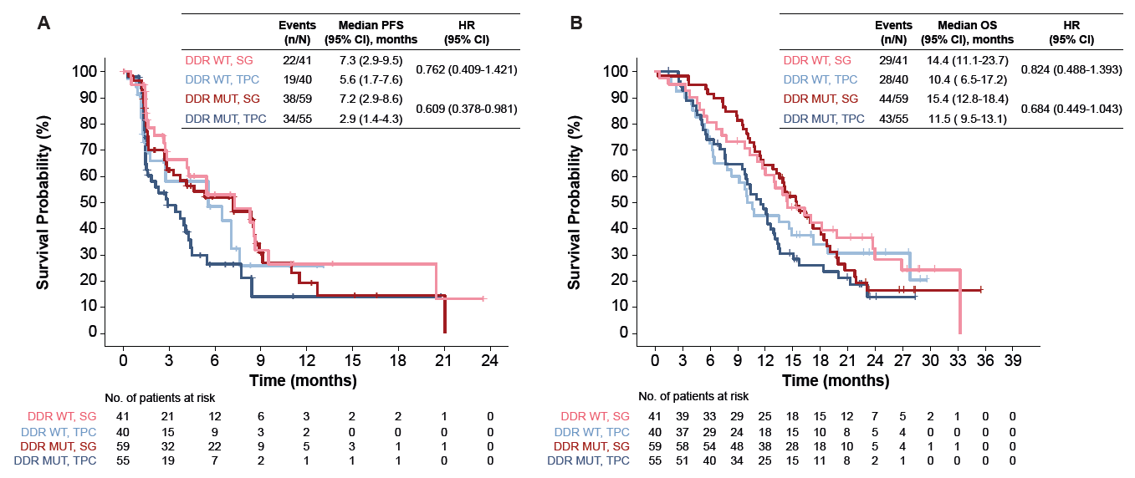
Results¹
Figure 2. PFS (A) and OS (B) of Patients With or Without DDR Mutations in the BE Population
BE, biomarker-evaluable; HR, hazard ratio; ITT, intent-to-treat; OS, overall survival; PFS, progression-free survival; SG, sacituzumab govitecan; TPC, treatment of physician’s choice.
1. Bardia A et al. ASCO 2024 #1075
Notes:
Key Points:
Of the 142 DDR pathway genes evaluated, 87 were mutated in this patient population
In the BE population, PFS (Figure 2A) and OS (Figure 2B) benefit of SG vs TPC was greater (as shown by smaller HRs) for patients with vs without DDR mutations
References:
Bardia A, et al. Genomic alterations in DNA damage response (DDR) genes in HR+/HER2- metastatic breast cancer (mBC) and impact on clinical efficacy with Sacituzumab Govitecan (SG): biomarker results from TROPiCS-02 study. Presented at ASCO 2024 Abstract #1075
Abbreviations:
BE, biomarker-evaluable; HR, hazard ratio; ITT, intent-to-treat; OS, overall survival; PFS, progression-free survival; SG, sacituzumab govitecan; TPC, treatment of physician’s choice; DDR, DNA damage response

Slide 8
Results¹
A greater benefit in ORR was also observed as shown by the larger odds ratio for patients with vs without DDR mutations (Table 2)
Table 2. ORR of Patients With or Without DDR Mutations in the BE Population
Treatment | DDR WT |  | DDR MUT n/N (%)
 | ORR n/N (%) | ORR Odds Ratio | ORR n/N (%) | ORR Odds Ratio
SG | 9/41 (22.0) | 1.6 (0.5-5.0) | 11/59 (18.6) | 4.0 (1.0-15.1)
TPC | 6/40 (15.0) |  | 3/55 (5.5)
BE, biomarker evaluable; DDR, DNA damage response; MUT, mutant; ORR, objective response rate; SG, sacituzumab govitecan; TPC, treatment of physician’s choice; WT, wild type.
1. Bardia A et al. ASCO 2024 #1075
Notes:
Key Points:
As per slide
References:
Bardia A, et al. Genomic alterations in DNA damage response (DDR) genes in HR+/HER2- metastatic breast cancer (mBC) and impact on clinical efficacy with Sacituzumab Govitecan (SG): biomarker results from TROPiCS-02 study. Presented at ASCO 2024 Abstract #1075
Abbreviations:
BE, biomarker evaluable; DDR, DNA damage response; MUT, mutant; ORR, objective response rate; SG, sacituzumab govitecan; TPC, treatment of physician’s choice; WT, wild type.

Slide 9

Results¹
Full Interaction Model to Identify DDR Genes That Are Potentially Predictive of SG Benefit Over TPC
Figure 3. Model to Identify DDR Genes With a Predictive Effect
Cox regression with interaction
87 DDR genes with mutation (out of 142) 195 patients (114 MUT, 81 WT)
HR₀
Exclude each DDR gene
from the DDR list
Bootstrap and Cox regression
Median HR > HR₀?
NO
86 DDR 195 patients (114-x MUT, 81+x WT)
genes
1000 HRsª
YES
1
HR₁
HR₂
HR₃
HR₄
HR₅
…
^{HR}1000
Genes contributing to the SG efficacy over TPC
Other DDR genes
Generalization by bootstrapping
ªHRs were evaluated for predictive effect in the interaction model.
DDR, DNA damage response; HR, hazard ratio; MUT, mutant; SG, sacituzumab govitecan; TPC, treatment of physician's choice; WT, wild type.
Among the DDR genes evaluated, 39 mutated genes contributed to the improved PFS with SG over TPC
These genes are: APEX1, APEX2, ATM, ATRIP, BLM, BRCA2, CHEK2, CUL4A, CUL4B, DNTT, ERCC2, ERCC6, ERCC8, EXO1, FANCF, FANCM, GTF2H1, HMGB1, HMGB1P40, MDC1, MRE11, MUTYH, NBN, NEIL1, PALB2, PARP1, PARP4, POLD1, PRKDC, RAD17, RAD50, RECQL4, RFC5, SLX4, TOP3A, WRN, XPC, XRCC2, XRCC6
47 mutated genes contributed to the improved OS with SG over TPC
These genes are: APEX2, ATM, ATRIP, CHEK2, CUL4A, CUL4B, DNTT, ERCC2, ERCC8, FAAP100, FANCA, FANCD2, FANCE, FANCF, FANCI, FANCM, FEN1, GTF2H1, HMGB1, HMGB1P40, LIG1, MDC1, MLH3, MRE11, MUTYH, NBN, NEIL1, PARP4, PMS2, POLD1, POLD3, POLM, PRKDC, RAD17, RAD23B, RAD51D, RAD54L, RAD52, RFC1, RFC5, RPA2, TOP3A, TOPBP1, XPA, XPC, XRCC2, XRCC6
1. Bardia A et al. ASCO 2024 #1075
Notes:
Key Points:
To enrich for DDR genes that contribute to the predictive benefit of SG over TPC, each of the 87 mutated genes was omitted, 1 at a time, and genes for which the predictability was reduced were selected for further analyses (Figure 3)
By comparing the numeric HRs to the HR in the all-inclusive model (HR₀ ), the list of genes was separated out by their potential contribution to predictive effect in the full interaction model
References:
Bardia A, et al. Genomic alterations in DNA damage response (DDR) genes in HR+/HER2- metastatic breast cancer (mBC) and impact on clinical efficacy with Sacituzumab Govitecan (SG): biomarker results from TROPiCS-02 study. Presented at ASCO 2024 Abstract #1075
Abbreviations:
DDR, DNA damage response; HR, hazard ratio; MUT, mutant; SG, sacituzumab govitecan; TPC, treatment of physician's choice; WT, wild type.

Slide 10
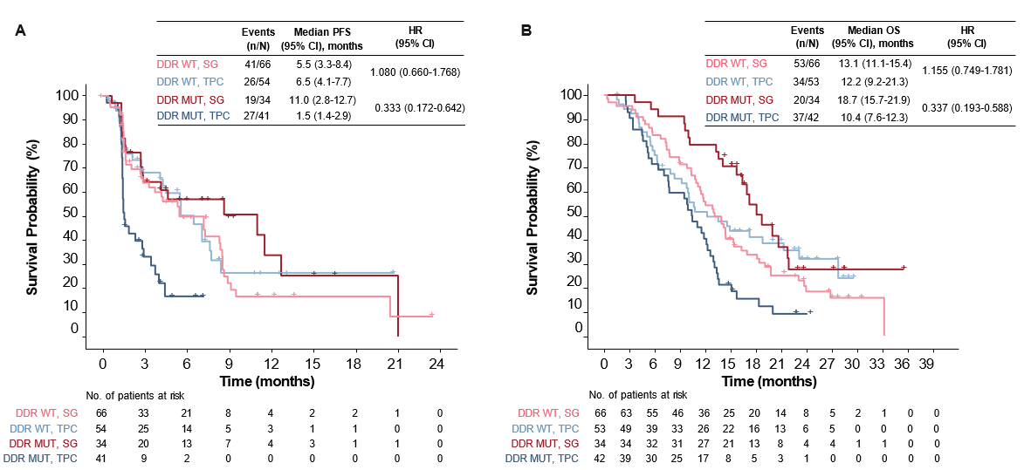
Results¹
PFS and OS in patients with or without mutations in predictive DDR genes (based on the lists outlined above for each outcome) in the BE population are shown in Figure 4
Figure 4. PFS (A) and OS (B) in Patients With or Without DDR-Predictive- Contributing Gene Mutations in the BE Population
BE, biomarker evaluable; DDR, DNA damage response; HR, hazard ratio; MUT, mutant; OS, overall survival; PFS, progression-free survival; SG, sacituzumab govitecan; TPC, treatment of physician’s choice; WT, wild type.
1. Bardia A et al. ASCO 2024 #1075
Notes:
Key Points:
Patients with DDR predictive contributing gene mutations in the BE population had numerically greater benefit in PFS vs WT (MUT HR = 0.333; WT HR =1.080) and OS (MUT HR = 0.337; WT HR = 1.155).
References:
Bardia A, et al. Genomic alterations in DNA damage response (DDR) genes in HR+/HER2- metastatic breast cancer (mBC) and impact on clinical efficacy with Sacituzumab Govitecan (SG): biomarker results from TROPiCS-02 study. Presented at ASCO 2024 Abstract #1075
Abbreviations:
BE, biomarker evaluable; DDR, DNA damage response; HR, hazard ratio; MUT, mutant; OS, overall survival; PFS, progression-free survival; SG, sacituzumab govitecan; TPC, treatment of physician’s choice; WT, wild type.

Slide 11
Limitations¹
Only 87 of the 142 DDR genes were mutated in the BE population, and only 114 of 195 patients had these mutations. Furthermore, for most of the genes evaluated, fewer than 5 patients had the mutation in a given gene
The current method did not consider non-DDR co-mutations (which may include key mutations that are associated with survival); thus, it is hard to separate out the effect of other key mutations from DDR mutations
The identified DDR genes that are potentially predictive of SG benefit over TPC might be overfitted to this study; validation of the predictive effect for greater SG benefit is needed
1. Bardia A et al. ASCO 2024 #1075
Notes:
Key Points:
As per slide
References:
Bardia A, et al. Genomic alterations in DNA damage response (DDR) genes in HR+/HER2- metastatic breast cancer (mBC) and impact on clinical efficacy with Sacituzumab Govitecan (SG): biomarker results from TROPiCS-02 study. Presented at ASCO 2024 Abstract #1075
Abbreviations:
BE, biomarker evaluable; DDR, DNA damage response; SG, sacituzumab govitecan; TPC, treatment of physician’s choice

Slide 12
Conclusions¹
Baseline characteristics, PFS, and OS were generally similar between patients with HR+/HER2– mBC in the ITT and BE population
In the BE population, SG benefit over TPC was observed in patients with wildtype and mutant DDR genes
Numerically greater median PFS, OS, and ORR benefits with SG over TPC were observed for patients with DDR deficient tumors, suggesting a possible synergy between the DDR pathway and antitumor effect of SG
Genes in the DDR pathways that contributed to the observed efficacy benefit of SG over TPC were identified
Further study of the synergistic effects of SG in combination with agents targeting the DDR pathway are warranted
1. Bardia A et al. ASCO 2024 #1075
Notes:
Key Points:
Authors conclude, while SG benefit over TPC was observed in both DDR WT and DDR MUT HR+/HER2– mBC, numerically greater benefit observed for patients with DDR deficient tumors suggest possible synergy between the DDR pathway and SG’s anti-tumor effect. However, due to study limitations, further study of the synergistic effects of SG in combination with agents targeting DDR pathway are needed
References:
Bardia A, et al. Genomic alterations in DNA damage response (DDR) genes in HR+/HER2- metastatic breast cancer (mBC) and impact on clinical efficacy with Sacituzumab Govitecan (SG): biomarker results from TROPiCS-02 study. Presented at ASCO 2024 Abstract #1075
Abbreviations:
PFS, progression free survival; OS, overall survival; ITT, intention to treat; HR, hormone receptor; HER2-, human epidermal growth factor receptor 2; mBC, metastatic breast cancer; BE, biomarker evaluable; DDR, DNA damage response; SG, sacituzumab govitecan; TPC, treatment of physician’s choice

Slide 13
Trodelvy▼ (sacituzumab govitecan)
▼Detta läkemedel är föremål för utökad övervakning.
Trodelvy ® (sacituzumabgovitekan) 200 mg pulver till koncentrat till infusionsvätska, lösning. Antineoplastiska medel. Antikropp-läkemedelskonjugat. Rx., EF.
Indikationer: Monoterapi vid behandling av vuxna patienter med icke-resektabel eller metastaserad, trippelnegativ bröstcancer (mTNBC) som tidigare har fått två eller flera systemiska behandlingar, varav minst en av dem mot avancerad sjukdom. Monoterapi vid behandling av vuxna patienter med icke-resektabel eller metastaserad hormonreceptor (HR)-positiv, HER2-negativ bröstcancer som har fått endokrinbaserad behandling och minst två ytterligare systemiska behandlingar för avancerad sjukdom.
Kontraindikationer: Överkänslighet mot sacituzumabgovitekan eller hjälpämne.
Varningar och försiktighet: Kan orsaka svår eller livshotande neutropeni. Det rekommenderas att patienternas blodvärden övervakas under behandlingen. Ska inte administreras om det absoluta antalet neutrofiler understiger 1 500/mm3 på dag 1 under någon cykel eller om antalet neutrofiler understiger 1 000/mm3 på dag 8 under någon cykel eller vid neutropen feber. Kan orsaka svår diarré. Ska inte administreras vid diarré av grad 3–4. Kan orsaka svår eller livshotande överkänslighet. Premedicinering rekommenderas och noggrann observation med avseende på infusionsrelaterade reaktioner. Primärprofylax med granulocytkolonistimulerande faktor (G-CSF) bör övervägas med start i den första behandlingscykeln hos patienter med ökad risk för febril neutropeni. Överväg profylax i efterföljande behandlingscykler om det är kliniskt indicerat. Hantering av biverkningar kan innebära tillfälligt avbrott, dosminskning eller avbruten behandling av sacituzumabgovitekan. För att förebygga cytostatikainducerat illamående och kräkningar rekommenderas förebyggande behandling
med antiemetika. Patienten måste övervakas under varje infusion och i minst 30 minuter efter varje infusion. Patienter med känd reducerad UGT1A1-aktivitet ska övervakas noga med avseende på biverkningar. Gravida kvinnor och fertila kvinnor ska informeras om den potentiella risken för foster.
Innehåller natrium, ska beaktas i relation till patientens totala natriumintag.
Innehavare av marknadsföringstillståndet: Gilead Sciences Ireland UC
För information: Kontakta Gilead Sciences Sweden AB, + 46 (0) 8 5057 1849. För fullständig information om dosering, varningar och försiktighet, interaktioner och biverkningar samt aktuell information om förpackningar och priser se www.fass.se
Baserad på produktresumé: 06/2025
SE-TRO-0187 Date of preparation Sept 2025

