Slide 1
Effect by HER2 IHC status in ASCENT
Disease: mTNBC
Drug: Trodelvy▼ (sacituzumab govitecan)
Category: Phase III
Treatment line: 2L and beyond
Presenter: Hurvitz
Congress: ESMO BC 2022
SE-TRO-0219 Date of preparation Sept 2025
▼Detta läkemedel är föremål för utökad övervakning.

Slide 2

Sacituzumab Govitecan Efficacy in Patients With Metastatic Triple-Negative Breast Cancer by HER2 Immunohistochemistry Status: Findings From the Phase 3 ASCENT Study
Poster 168P
Sara A. Hurvitz,¹ Aditya Bardia,² Kevin Punie,³ Kevin Kalinsky,⁴ Javier Cortés,⁵ Joyce O’Shaughnessy,⁶ Lisa A. Carey,⁷ Hope S. Rugo,⁸ Oh Kyu Yoon,⁹ Yang Pan,⁹ Rosemary Delaney,⁹ Scott Hofsess,⁹ Paul Hodgkins,⁹ See Phan,⁹ Véronique Diéras¹⁰
¹David Geffen School of Medicine, University of California, Los Angeles, Jonsson Comprehensive Cancer Center, Los Angeles, CA, USA; ²Massachusetts General Hospital Cancer Center, Harvard Medical School, Boston, MA, USA; ³University Hospitals Leuven, Leuven, Belgium;⁴Winship Cancer Institute, Emory University, Atlanta, GA, USA; ⁵International Breast Cancer Center (IBCC), Quiron Group, Madrid & Barcelona, Spain; ⁶Baylor University Medical Center, Texas Oncology, US Oncology, Dallas, TX, USA; ⁷University of North Carolina Lineberger Comprehensive Cancer Center, Chapel Hill, NC, USA; ⁸University of California San Francisco Helen Diller Family Comprehensive Cancer Center, San Francisco, CA, USA; ⁹Gilead Sciences, Inc, Foster City, CA, USA; ¹⁰Centre Eugène Marquis, Rennes, France.
External Use and Distribution
SE-TRO-0219 Date of preparation Sept 2025

Slide 3
Background
Triple-Negative and HER2-Low Breast Cancer
The 2018 American Society of Clinical Oncology/College of American Pathologists (ASCO/CAP) guidelines on human epidermal growth factor receptor 2 (HER2) testing categorize breast cancer as either HER2-negative or HER2-positive​¹
“HER2-Low” has recently emerged as a potential subcategory of HER2-negative breast cancer based on the increasing number of clinical development programs in this population²
      “HER2-Low” refers to breast cancer with immunohistochemistry (IHC) HER2 expression score 1+, or 2+ confirmed by an in situ hybridization (ISH)-negative result (HER2 non-amplified)
Triple-negative breast cancer (TNBC), which comprises 15%-20% of breast cancers, is defined as the absence of estrogen and progesterone receptors and lack of HER2 gene amplification
According to updated ASCO/CAP HER2 scoring guidelines, approximately 37% of patients with TNBC have HER2-Low status³
Notes:
MAIN MESSAGE:
“HER2-low” has emerged lately as a potential subcategory of HER2– BC and refers to breast cancer with IHC HER2 expression score 1+, or 2+ confirmed by in situ hybridization (ISH) negative (non-amplified).
KEY POINTS:
2018 ASCO/CAP Guidelines on human epidermal growth factor receptor (HER2) testing categorize breast cancer as either HER2-negative or HER2-positive
The term “HER2-low” sometimes refers to those HER2-negative breast cancers with immunohistochemistry (IHC) scores of 1+ or 2+ with confirmatory in situ hybridization (ISH) testing negative (non-amplified)
Triple negative breast cancer (TNBC) is defined as the absence of oestrogen and progesterone receptors and lack of HER2 gene amplification and comprises 15% to 20% of breast cancers
Approximately 37% of patients with TNBC have HER2-Low status using updated ASCO/CAP HER2 scoring guidelines
REFERENCE:
Hurvitz SA, et al. ESMO BC 2022. Poster 168P
ABBREVIATIONS:
TNBC, triple negative breast cancer; HER2, human epidermal growth factor receptor 2; IHC, immunohistochemistry; ISH, in situ hybridization.

Slide 4
Background
Sacituzumab Govitecan (SG)
Whereas HER2 expression is heterogeneous, Trop-2 is highly expressed in all breast cancer subtypes, and is linked to poor prognosis^{4,5}
SG is an antibody-drug conjugate composed of an anti–Trop-2 antibody coupled to SN-38 via a proprietary, hydrolyzable linker (Figure 1)⁶⁻¹⁰
Results from the confirmatory phase 3 ASCENT study (NCT02574455) demonstrated a significant survival improvement of SG vs single-agent chemotherapy, with a manageable safety profile in the second-line or greater metastatic TNBC (mTNBC) setting¹¹
      Median progression-free survival (PFS) of 4.8 vs 1.7 months (HR, 0.43; 95% CI, 0.35-0.54) in the full trial population
      Median overall survival (OS) of 11.8 vs 6.9 months (HR, 0.51; 95% CI, 0.41-0.62) in the full trial population
SG is authorized in the European Union for use in patients with mTNBC who received ≥2 prior chemotherapies (at least 1 in the metastatic setting)¹²
This analysis evaluates the efficacy of SG in mTNBC by HER2 status in the ASCENT study
Notes:
MAIN MESSAGE:
The objective of this retrospective analysis is to evaluate the efficacy of SG in mTNBC by HER2 status, using clinical data from the ASCENT study.
KEY POINTS:
Whereas HER2 expression is heterogeneous, Trop-2 is expressed in all subtypes of breast cancer, and is linked to poor prognosis
SG is an antibody-drug conjugate composed of an anti–Trop-2 antibody coupled to SN-38 via a proprietary, hydrolyzable linker
Results from the confirmatory phase 3 ASCENT study (NCT02574455) demonstrated a significant survival improvement of SG over single-agent chemotherapy, with a manageable safety profile in the second-line (2L) mTNBC setting
The median PFS for SG was 4.8 vs 1.7 months for TPC (HR, 0.43; 95% CI, 0.35-0.54) in the full trial population
The median overall survival for SG was 11.8 vs 6.9 months for TPC (HR, 0.51; 95% CI, 0.41-0.62) in the full trial population
SG is authorized in the European Union for use in patients with mTNBC who received ≥2 prior chemotherapies (at least 1 in the metastatic setting)
The Objective of this retrospective analysis is to evaluate the efficacy of SG in mTNBC by HER2 status, using clinical data from the ASCENT study
REFERENCE:
Hurvitz SA, et al. ESMO BC 2022. Poster 168P.
ABBREVIATIONS:
mTNBC, metastatic triple negative breast cancer; HER2, human epidermal growth factor receptor 2; ADC, antibody drug conjugate

Slide 5
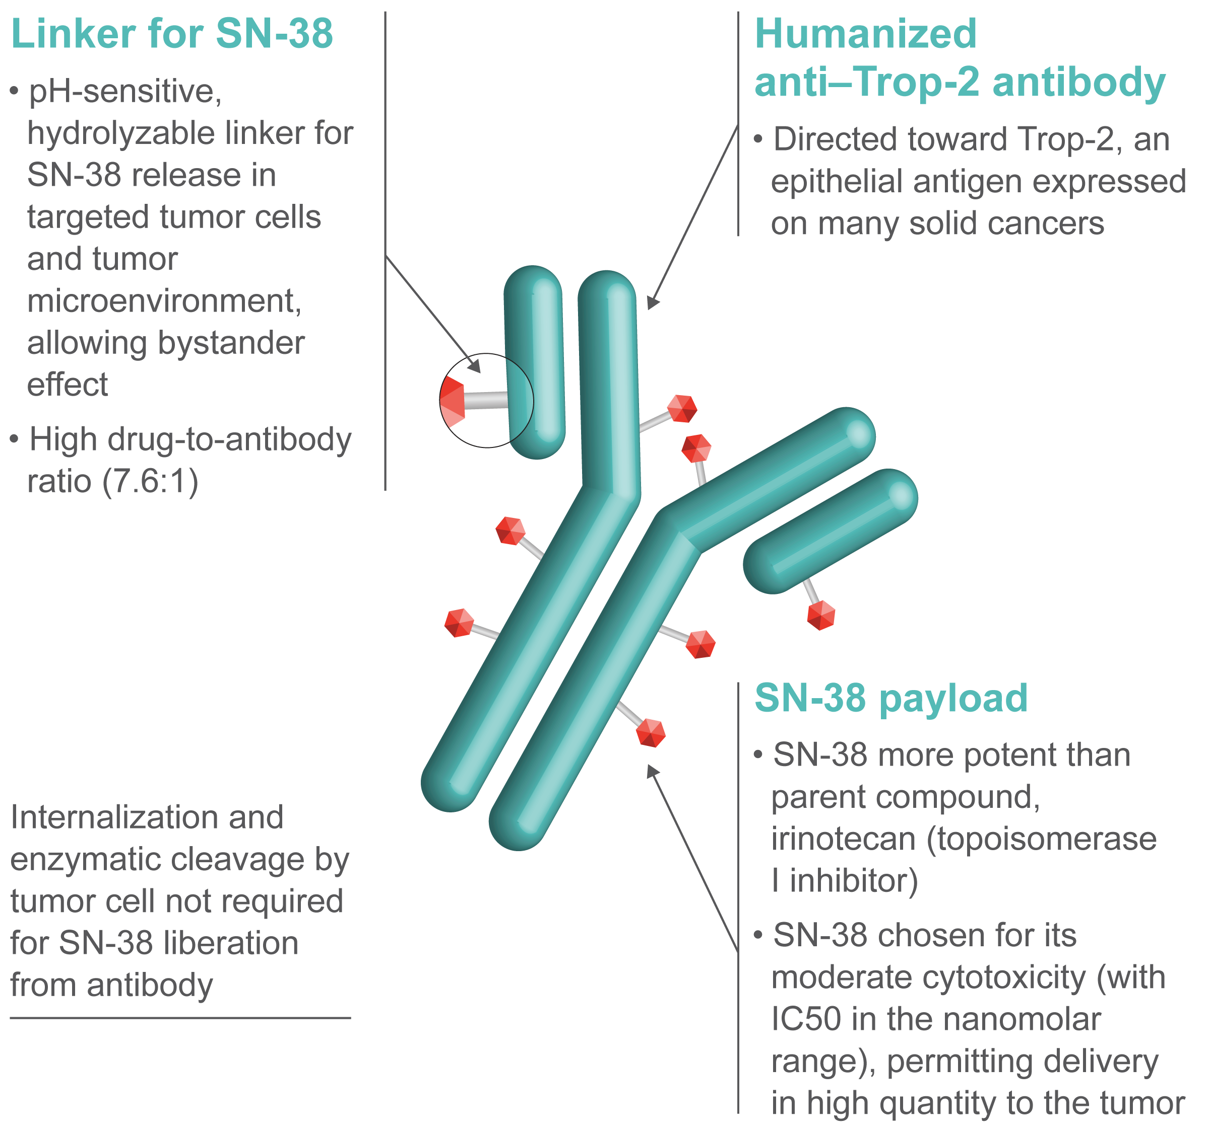
Sacituzumab Govitecan
Figure 1. Sacituzumab Govitecan Antibody-Drug Conjugate
Trop-2, trophoblast cell surface antigen 2.
Notes:
MAIN MESSAGE:
SG is the first approved Trop-2–directed ADC consisting of humanized anti-Trop-2 monoclonal antibody (hRS7) conjugated with the active metabolite of irinotecan by a hydrolysable CL2A linker
KEY POINTS:
SG is the first approved Trop-2–directed ADC consisting of an anti-Trop-2 monoclonal antibody (hRS7), active payload (SN-38), and hydrolysable linker (CL2A)
The humanized monoclonal antibody (hRS7) selectively binds to Trop-2, a cell surface antigen expressed in TNBC cancer cells
The cytotoxic payload SN-38 is moderately toxic and more active than its parent compound irinotecan
SN-38 functions as a topoisomerase 1 (TOP1) inhibitor that blocks DNA replication, causing dsDNA breaks and tumor cell apoptosis
SG employs a hydrolysable linker (CL2A), which is responsible for its unique drug-release profile, including bystander effect
REFERENCES:
Cardillo TM, et al. Bioconjugate Chem. 2015;26:919-931;
Rugo HS, et al. Future Oncol. 2020;16:705-715;
Kciuk M, et al. Int J Mol Sci. 2020;21(14):4919.
ABBREVIATIONS:
ADC, antibody-drug conjugate; dsDNA, double-stranded deoxyribonucleic acid; hRS7, humanized anti–Trop-2 monoclonal antibody; SG, sacituzumab govitecan; TNBC, triple negative breast cancer; TOP1, topoisomerase 1; Trop-2, trophoblast cell surface antigen-2.

Slide 6
Methods
In the ASCENT trial (Figure 2), patients with mTNBC refractory to or relapsing after ≥2 prior chemotherapies (at least 1 in the metastatic setting) were randomized 1:1 to receive either:¹¹
SG (10 mg/kg IV on days 1 and 8, every 21 days) or
Treatment of physician’s choice (TPC; capecitabine, eribulin, vinorelbine, or gemcitabine)
Primary endpoint was PFS per RECIST 1.1; secondary endpoints included OS and objective response rate (ORR)
Patients with known HER2-positive disease were ineligible for ASCENT, and HER2-negative status was based on local assessment of the most recent biopsy/pathology report
HER2-negative was defined as HER2 IHC0, or IHC1+; if IHC2+, then ISH-negative
For this post hoc subgroup analysis, local IHC and ISH results for the intention-to-treat (ITT) population of ASCENT were analyzed retrospectively to determine SG efficacy by HER2 status:
    HER2 IHC0
    HER2-Low, defined as HER2 IHC1+, or IHC2+ and ISH-negative
Notes:
MAIN MESSAGE:
For this post hoc subgroup analysis, local IHC results for the full intent-to-treat (ITT) population of ASCENT were analyzed retrospectively to determine SG efficacy by HER2 status, which included HER2-Low patients.
KEY POINTS:
In the phase 3 ASCENT trial, patients with mTNBC refractory to or relapsing after ≥2 prior chemotherapies (at least 1 in the metastatic setting) were randomized 1:1 to receive SG (10 mg/kg IV on days 1 and 8, every 21 days) or single agent chemotherapy treatment of physician’s choice (TPC; capecitabine, eribulin, vinorelbine, or gemcitabine)
Primary endpoint was PFS per RECIST 1.1 by blind independent central review in brain metastases-negative patients.
Whereas patients with known HER2-positive disease were ineligible for ASCENT, HER2-negative status was based on local assessment was eligible
HER2-negative was defined as HER2 IHC0, or IHC1+; if IHC2+, then FISH-negative
For this post hoc subgroup analysis, local IHC results for the full intent-to-treat (ITT) population of ASCENT were analyzed retrospectively to determine SG efficacy by HER2 status
HER 2 IHC0
HER2-Low, defined as HER2 IHC1+, or IHC2+ and FISH-negative
REFERENCE:
Hurvitz SA, et al. ESMO BC 2022. Poster 168P.
ABBREVIATIONS:
HER2, human epidermal growth factor receptor 2; IHC, immunohistochemistry; SG, sacituzumab govitecan; TPC, treatment of physician’s choice; FISH, fluorescence in situ hybridization.

Slide 7
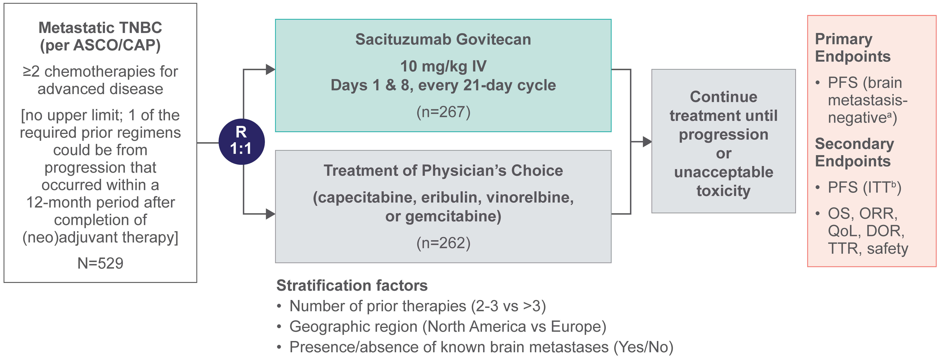
Methods
Figure 2. ASCENT Study Design (NCT02574455)
Adapted from N Engl J Med. Bardia A, Hurvitz SA, Tolaney SM, et al. Sacituzumab govitecan in metastatic triple-negative breast cancer. Vol. 384, pp 1529-1541. Copyright ©2021 Massachusetts Medical Society. Reused with permission from Massachusetts Medical Society.
ªPFS measured by an independent, centralized, and blinded group of radiology experts who assessed tumor response using RECIST 1.1 criteria in patients without brain metastasis. ^{b}The ITT population includes all randomized patients (with and without brain metastases). Baseline brain MRI only required for patients with known brain metastasis.
ASCO/CAP, American Society of Clinical Oncology/College of American Pathologists; DOR, duration of response; ITT, intention-to-treat; IV, intravenous; MRI, magnetic resonance imaging; ORR, objective response rate; OS, overall survival; PFS, progression-free survival; QoL, quality of life; R, randomization; TNBC, triple-negative breast cancer; TTR, time to response. National Institutes of Health. https://clinicaltrials.gov/ct2/show/NCT02574455.
7
Notes:
MAIN MESSAGE:
SG was evaluated in a Phase 3 confirmatory study in patients with refractory/relapsed mTNBC treated with 2 or more prior therapies
KEY POINTS:
At study initiation, 529 patients were randomized to receive SG or a single-agent chemotherapy of the physician’s choice
At baseline, all patients enrolled in the ASCENT study had CT- or MRI-confirmed metastatic disease and TNBC diagnosis based on ASCO/CAP criteria
To be eligible for the study, patients were required to have at least 2 chemotherapies for unresectable, locally advanced, or metastatic disease; 1 of which could be neoadjuvant therapy if progression occurred within a 12-month period after completion of neoadjuvant therapy
Patients were randomized 1:1 to receive either:
SG 10 mg/kg IV on days 1 and 8 of every 21-day cycle, or
Single-agent chemotherapy of physician’s choice until progression or unacceptable toxicity
The primary endpoint was PFS, measured by an independent, centralized, and blinded group of radiology experts who assessed tumor response using RECIST v1.1 criteria in patients without known brain metastases¹
Secondary endpoints included PFS for the full population (all randomized patients with and without brain metastases), OS, ORR, DOR, TTR, safety, and QoL¹
Patients were stratified according to:
Number of prior chemotherapies: 2-3 vs >3,
Geographic region: North America vs Europe, and
Presence or absence of known brain metastases at baseline
The data cutoff was March 11, 2020
REFERENCES:
1. Bardia A, et al. N Engl J Med. 2021;384(16):1529-1541;
2. National Institutes of Health. https://clinicaltrials.gov/ct2/show/NCT02574455. Accessed Dec 5, 2021
ABBREVIATIONS:
ASCO/CAP, American Society of Clinical Oncology/College of American Pathologists; CT, computed tomography; DOR, duration of response; IV, intravenous; MRI, magnetic resonance imaging; mTNBC, metastatic triple negative breast cancer; ORR, objective response rate; OS, overall survival; PFS, progression-free survival; QoL, quality of life; R, randomization; RECIST v1.1, Response Evaluation Criteria in Solid Tumors, version 1.1; SG, sacituzumab govitecan; TNBC, triple negative breast cancer; TTR, time to response, TPC, treatment of physician’s choice.

Slide 8
Results
Patients
Of the 529 patients from the ASCENT ITT population, 79% were HER2-evaluable by IHC (SG vs TPC; Table 1):
      HER2 IHC0: 149 (56%) vs 144 (55%) patients
      HER2-Low: 63 (24%) vs 60 (23%) patients
      Missing specific HER2 results: 55 (21%) vs 58 (22%) patients
Demographics and baseline characteristics between the ASCENT ITT, HER2-evaluable ITT, HER2 IHC0, and HER2-Low populations were comparable
Notes:
MAIN MESSAGE:
Demographics and baseline characteristics between the ASCENT ITT, HER2-evaluable ITT, HER2 IHC0, and HER2-Low populations were comparable
KEY POINTS:
Of the 529 patients from the ASCENT ITT population, 79% were HER2-evaluable by IHC
79% for SG vs. 78% for TPC, respectively, were evaluable by IHC:
149 (56%) patients for SG vs 144 (55%) patients for TPC were HER2 IHC0
63 (24%) patients for SG vs 60 (23%) patients for TPC were HER2-Low
55 (21%) for SG vs 58 (22%) patients for TPC had missing specific HER2 results
Demographics and baseline characteristics between the ASCENT ITT, HER2-evaluable ITT, HER2 IHC0, and HER2-Low populations were comparable
REFERENCE:
Hurvitz SA, et al. ESMO BC 2022. Poster 168P.

Slide 9
Results
Table 1. Demographics and Baseline Characteristics of
ASCENT ITT and ITT With HER2 IHC Populations
 | ITT |  | ITT With HER2 IHC |  | HER2 IHC0 |  | HER2-Lowª
 | SG (n=267) | TPC (n=262) | SG (n=212) | TPC (n=204) | SG (n=149) | TPC (n=144) | SG (n=63) | TPC (n=60)
Median age at study entry, y (range) | 54 (46-61) | 53 (46-62) | 54 (46-61) | 53 (46-60) | 54 (45-60) | 53 (46-60) | 55 (47-61) | 54 (46-59)
Race, n (%)
White | 215 (81) | 203 (77) | 170 (80) | 163 (80) | 115 (77) | 119 (83) | 55 (87) | 44 (73)
Black | 28 (10) | 34 (13) | 24 (11) | 25 (12) | 21 (14) | 15 (10) | 3 (5) | 10 (17)
Asian | 13 (5) | 9 (3) | 12 (6) | 5 (2) | 9 (6) | 3 (2) | 3 (5) | 2 (3)
Other | 11 (4) | 16 (6) | 6 (3) | 11 (5) | 4 (3) | 7 (5) | 2 (3) | 4 (7)
ECOG PS, n (%)
0 | 121 (45) | 108 (41) | 92 (43) | 92 (45) | 63 (42) | 63 (44) | 29 (46) | 29 (48)
1 | 146 (55) | 154 (59) | 120 (57) | 112 (55) | 86 (58) | 81 (56) | 34 (54) | 31 (52)
Number of prior chemotherapies, n (%)
2-3 | 184 (69) | 181 (69) | 146 (69) | 139 (68) | 101 (68) | 97 (67) | 45 (71) | 42 (70)
>3 | 83 (31) | 81 (31) | 66 (31) | 65 (32) | 48 (32) | 47 (33) | 18 (29) | 18 (30)
ªHER2-Low defined as IHC1+, or IHC2+ and ISH-negative.
ECOG PS, Eastern Cooperative Oncology Group performance status; HER2, human epidermal growth factor receptor 2; IHC, immunohistochemistry; ISH, in situ hybridization; ITT, intention-to-treat; SG, sacituzumab govitecan; TPC, treatment of physician’s choice
Notes:
MAIN MESSAGE:
Demographics and baseline characteristics between the SG and TPC subgroup arms were generally balanced across all subgroups and consistent with the full ITT population
KEY POINTS:
The median ages for patients in all treatment groups was similar and as follows:
ITT: SG 54 years and TPC 53 years
ITT with HER2 IHC: SG 54 years and TPC 53 years
ITT with HER2 IHC0: SG 54 years and TPC 53 years
HER2-Low: SG 55 years and TPC 54 years
Distribution of patients according to the race was balanced across all treatment arms and is shown in Table 1
All patients had an ECOG PS of 0 or 1 and this distribution was generally balanced across all treatment arms
In the ITT group
45% of patients in the SG arm and 41% in TPC arms had an ECOG PS of 0
55% of patients in the SG arm and 59% in TPC arms had an ECOG PS of 1
In the ITT with HER2 IHC group
43% of patients in the SG arm and 45% in TPC arms had an ECOG PS of 0
57% of patients in the SG arm and 55% in TPC arms had an ECOG PS of 1
In the HER2-IHC0 group
42% of patients in the SG arm and 44% in TPC arms had an ECOG PS of 0
58% of patients in the SG arm and 56% in TPC arms had an ECOG PS of 1
In the HER2-Low group
46% of patients in the SG arm and 48% in TPC arms had an ECOG PS of 0
54% of patients in the SG arm and 52% in TPC arms had an ECOG PS of 1
The prior number of chemotherapies was generally balanced across all groups
In the ITT group
69% of patients in the SG and TPC arm had a prior number of chemotherapies of 2-3
31% of patients in the SG and TPC arm had more than 3 prior number of chemotherapies
In the ITT with HER2 IHC group
69% of patients in the SG arm and 68% in the TPC arm had a prior number of chemotherapies of 2-3
31% of patients in the SG arm and 32% in the TPC arm had more than 3 prior number of chemotherapies
In the HER2 IHC0 group
68% of patients in the SG arm and 67% in the TPC arm had a prior number of chemotherapies of 2-3
32% of patients in the SG arm and 33% in the TPC arm had more than 3 prior number of chemotherapies
In the HER2-Low group
71% of patients in the SG arm and 70% in the TPC arm had a prior number of chemotherapies of 2-3
29% of patients in the SG arm and 30% in the TPC arm had more than 3 prior number of chemotherapies
REFERENCE:
Hurvitz SA, et al. ESMO BC 2022. Poster 168P.
ABBREVIATIONS:
ECOG, Eastern Cooperative Oncology Group; HER2, human epidermal growth factor receptor 2; IHC, immunohistochemistry; SG, sacituzumab govitecan; TPC, treatment of physician’s choice; y, years.

Slide 10
Results
Efficacy by HER2 Status
SG significantly improves PFS and OS vs TPC in both HER2 IHC0 and HER2-Low mTNBC
      Median PFS (Figure 3A and 3B): HER2 IHC0 (4.3 vs 1.6 months) and HER2-Low (6.2 vs 2.9 months) vs ITT (4.8 vs 1.7 months)
      Median OS (Figure 4A and 4B): HER2 IHC0 (11.3 vs 5.9 months) and HER2-Low (14.0 vs 8.7 months) vs ITT (11.8 vs 6.9 months)
      Clinical benefit with SG vs TPC was comparable to that observed in the ASCENT ITT population, regardless of HER2 status
      Hazard ratios for PFS and OS in HER2 IHC0 and HER2-Low were comparable to that of the ITT population (Figure 5)
ORR was numerically higher with SG vs TPC in HER2 IHC0 (31% vs 3%) and HER2-Low (32% vs 8%; Table 2) and comparable to that of the ITT population (31% vs 4%)¹¹
Notes:
MAIN MESSAGE:
In the phase 3 ASCENT study, a similar clinical benefit from SG over TPC was observed, consistent with that of the ASCENT full ITT population, regardless of HER2 status.
KEY POINTS:
The improvement in survival outcomes for SG vs TPC in the HER2 IHC0 and HER2-Low subgroups were comparable to that of the ASCENT ITT population
The median PFS for HER2 IHC0 was 4.3 vs 1.6 months and the median PFS for HER2-Low was 6.2 vs 2.9 months. The ITT PFS was 4.8 months for SG vs 1.7 months for TPC
The median OS for HER2 IHC0 was 11.3 vs 5.9 months and the median OS for HER2-Low was 14.0 vs 8.7 months. The ITT OS was 11.8 months for SG vs 6.9 months for TPC
Hazard ratios for median PFS and OS in the HER2 IHC0 and HER2-Low subgroups were comparable to that of the ITT population
The objective response rate (ORR) was numerically higher with SG vs TPC in the HER2 IHC0 (31% vs 3%) and HER2-Low subgroups (32% vs 8%) than in the Full population (31% vs 4%)
REFERENCE:
Hurvitz SA, et al. ESMO BC 2022. Poster 168P.

Slide 11
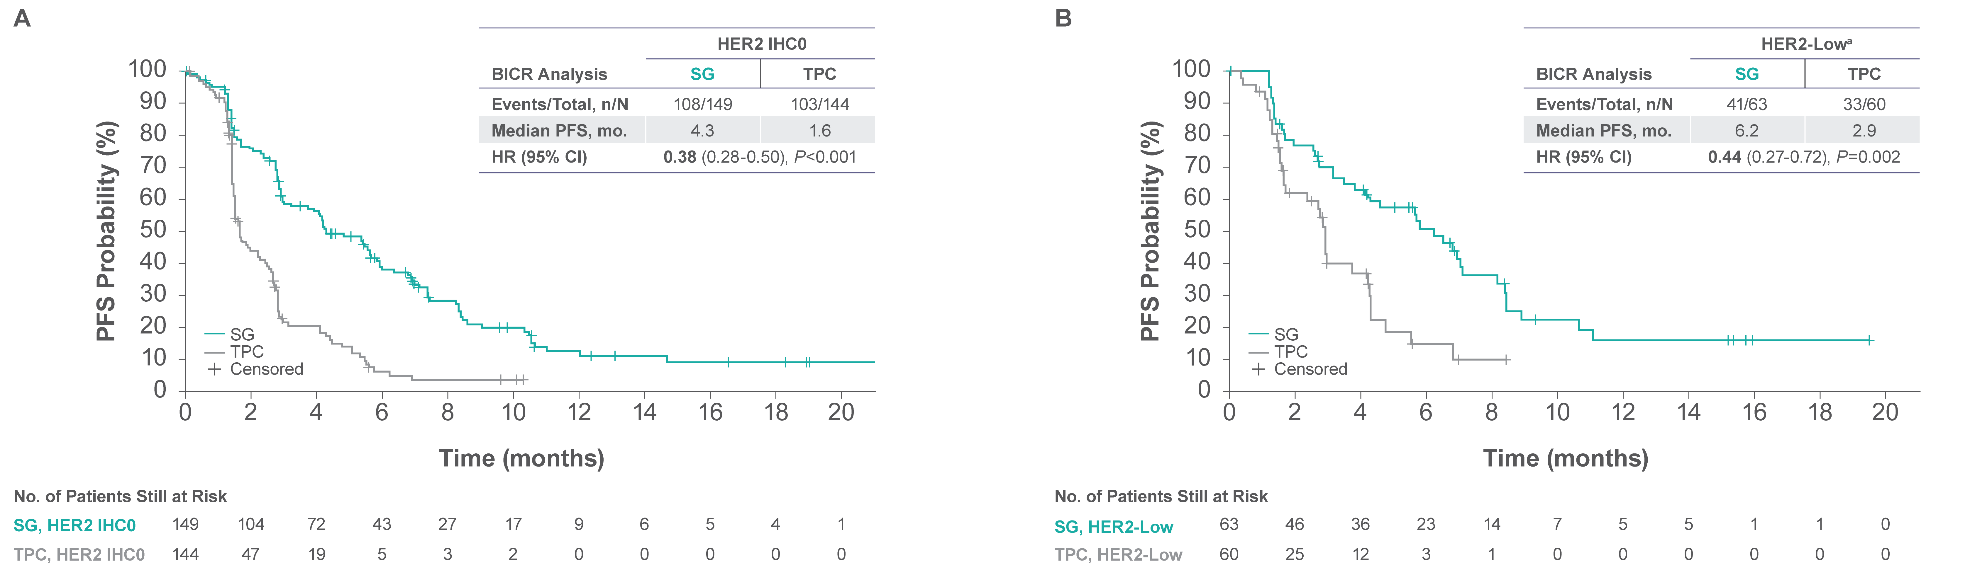
Results
Figure 3. Progression-Free Survival
ªHER2-Low defined as IHC1+, or IHC2+ and ISH-negative.
BICR, blinded independent central review; HER2, human epidermal growth factor receptor 2; IHC, immunohistochemistry; ISH, in situ hybridization; PFS, progression-free survival; SG, sacituzumab govitecan;
TPC, treatment of physician’s choice.
Notes:
MAIN MESSAGE:
In this subgroup of patients, the improvement in PFS outcomes for SG vs TPC in the HER2 IHC0 and HER2-Low subgroups were comparable to that of the ASCENT ITT population
KEY POINTS:
Median PFS: HER2 IHC0 (4.3 vs 1.6 months) and HER2-Low (6.2 vs 2.9 months; Figure 3A and 3B)
The improvement in PFS outcomes for SG vs TPC in the HER2 IHC0 and HER2-Low subgroups were comparable to that of the ASCENT ITT population (4.8 vs 1.7 month; HR=0.43; CI 0.35-0.54, P<0.001)
REFERENCE:
Hurvitz SA, et al. ESMO BC 2022. Poster 168P.
ABBREVIATIONS:
BICR, blinded independent central review; HER2, human epidermal growth factor receptor 2; IHC, immunohistochemistry; PFS, progression-free survival; SG, sacituzumab govitecan; TPC, treatment of physician’s choice

Slide 12
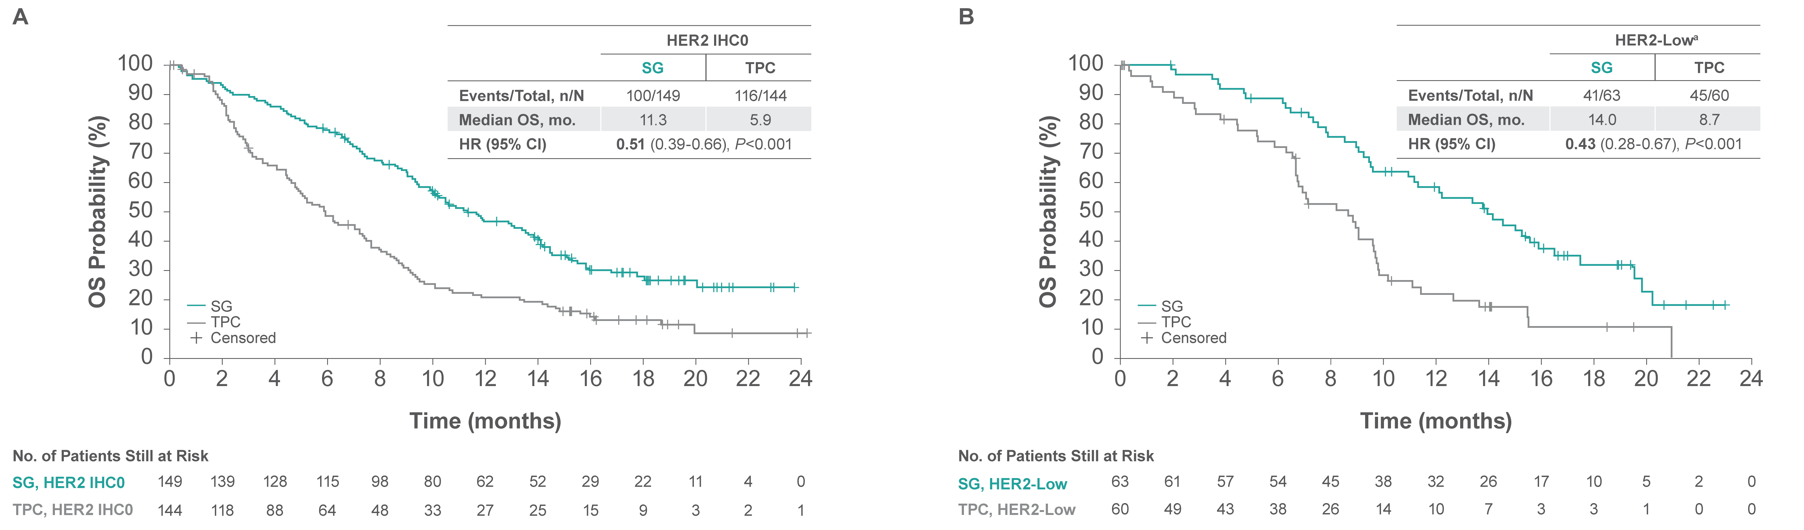
Results
Figure 4. Overall Survival
ªHER2-Low defined as IHC1+, or IHC2+ and ISH-negative.
HER2, human epidermal growth factor receptor 2; IHC, immunohistochemistry; ISH, in situ hybridization; OS, overall survival; SG, sacituzumab govitecan; TPC, treatment of physician’s choice
Notes:
MAIN MESSAGE:
In this subgroup of patients, the improvement in OS outcomes for SG vs TPC in the HER2 IHC0 and HER2-Low subgroups were comparable to that of the ASCENT ITT population
KEY POINTS:
Median OS: HER2 IHC0 (11.3 vs 5.9 months) and HER2-Low (14.0 vs 8.7 months; Figure 4A and 4B)
The improvement in OS outcomes for SG vs TPC in the HER2 IHC0 and HER2-Low subgroups were comparable to that of the ASCENT ITT population (11.8 vs 6.9 month; HR=0.51; CI 0.41-0.62, P<0.001)
REFERENCE:
Hurvitz SA, et al. ESMO BC 2022. Poster 168P.
ABBREVIATIONS:
HER2, human epidermal growth factor receptor 2; IHC, immunohistochemistry; OS, overall survival; SG, sacituzumab govitecan; TPC, treatment of physician’s choice.

Slide 13
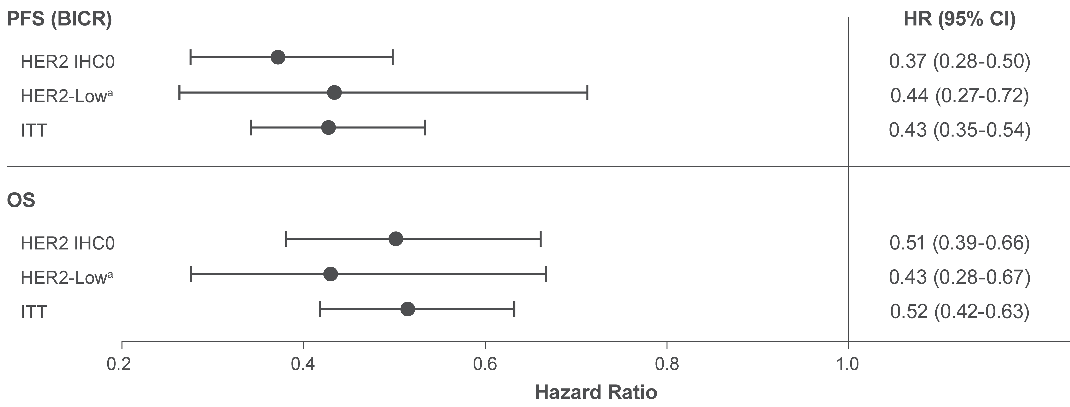
Results
Figure 5. Progression-Free and Overall Survival Hazard Ratios by
HER2 Status
ªHER2-Low defined as IHC1+, or IHC2+ and ISH-negative.
BICR, blinded independent central review; HER2, human epidermal growth factor receptor 2; IHC, immunohistochemistry; ISH, in situ hybridization; ITT, intention-to-treat; OS, overall survival;
PFS, progression-free survival.
Notes:
MAIN MESSAGE:
Hazard ratios for median PFS and OS in the HER2 IHC0 and HER2-Low subgroups were comparable to that of the ITT population
KEY POINTS:
The Hazard ratios for median PFS for the HER2 IHC0 cohort were HR 0.37 (95% CI 0.28, 0.50)
The Hazard ratios for median PFS for the HER2 Low cohort were HR 0.44 (95% CI 0.27, 0.72)
The Hazard ratios for median PFS for the ITT cohort were HR 0.43 (95% CI 0.35, 0.54)
The Hazard ratios for median OS for the HER2 IHC0 cohort were HR 0.51 (95% CI 0.39, 0.66)
The Hazard ratios for median OS for the HER2 Low cohort were HR 0.43 (95% CI 0.28, 0.67)
The Hazard ratios for median OS for the ITT cohort were HR 0.52 (95% CI 0.42, 0.63)
REFERENCE:
Hurvitz SA, et al. ESMO BC 2022. Poster 168P.
ABBREVIATIONS:
HER2, human epidermal growth factor receptor 2; IHC, immunohistochemistry; OS, overall survival; SG, sacituzumab govitecan; TPC, treatment of physician’s choice.

Slide 14
Results
Table 2. Overall Response
 | HER2 IHC0 |  | HER2-Lowª |  | ITT | ITT
 | SG (n=149) | TPC (n=144) | SG (n=63) | TPC (n=60) | SG​ (n=267)​ | TPC​ (n=262)​
ORR, n (%) | 46 (31) | 5 (3) | 20 (32) | 5 (8) | 83 (31)​ | 11 (4)​
Best overall response, n (%) |  |  |  |  | ​ | ​
CR | 3 (2) | 0 | 3 (5) | 1 (2) | 10​ (4) | 2​ (1)
PR | 43 (29) | 5 (3) | 17 (27) | 4 (7) | 73​ (27) | 9​ (3)
SD | 55 (37) | 33 (23) | 23 (37) | 22 (40) | 96​ (36) | 71​ (27)
PD | 32 (21) | 57 (40) | 17 (27) | 15 (25) | 65​ (24) | 100​ (38)
NE | 16 (11) | 49 (34) | 3 (5) | 18 (30) | 23​ (9) | 80​ (31)
CBR, n (%) | 101 (68)​ | 38 (26)​ | 43 (68)​ | 27 (45)​ | 179 (67)​ | 82 (31)​
Median DOR, mo. (95% CI) | 6.9 (5.4-9.0)​ | 2.9 (2.8-NE)​ | 5.6 (4.3-NE)​ | 3.6 (2.9-NE)​ | 6.3 (5.5-9.0)​ | 3.6 (2.8-NE)​
ªHER2-Low defined as IHC1+, or IHC2+ and ISH-negative.
CBR, clinical benefit rate; CR, complete response; DOR, duration of response; NE, not evaluable; ORR, objective response rate; PR, partial response; SD, stable disease; HER2, human epidermal growth factor receptor 2; IHC, immunohistochemistry; ISH, in situ hybridization; ITT, intention-to-treat; SG, sacituzumab govitecan; TPC, treatment of physician’s choice.
Notes:
MAIN MESSAGE:
In the phase 3 ASCENT study, a similar clinical benefit from SG over TPC was observed, consistent with that of the ASCENT full ITT population, regardless of HER2 status.
KEY POINTS:
The efficacy endpoints were as follows for HER2 IHC0:
ORR: 31% with SG vs 3% with TPC
CR: 3% with SG vs 0% with TPC
PR: 43% with SG vs 5% with TPC
SD: 55% with SG vs 33% with TPC
PD: 32% with SG vs 57% with TPC
NE: 16% with SG vs 49% with TPC
CBR: 68% with vs 26% with TPC
Median DOR: 6.9 months with SG vs 2.9 months with TPC
The efficacy endpoints were as follows for HER2-Low (defined as IHC1+ or ICH2+ and ISH-negative):
ORR: 32% with SG vs 8% with TPC
CR: 3% with SG vs 1% with TPC
PR: 17% with SG vs 4% with TPC
SD: 23% with SG vs 22% with TPC
PD: 17% with SG vs 15% with TPC
NE: 3% with SG vs 18% with TPC
CBR: 68% with vs 45% with TPC
Median DOR: 5.6 months with SG vs 3.6 months with TPC
REFERENCE:
Hurvitz SA, et al. ESMO BC 2022. Poster 168P.
ABBREVIATIONS:
CBR, clinical benefit rate; CR, complete response; DOR, duration of response; mDOR, median DOR; ORR, objective response rate; PD, progressive disease; PR, partial response; SD, stable disease; NE, not evaluable; SG, sacituzumab govitecan; TPC, treatment of physician’s choice.

Slide 15
Conclusions
Clinical benefit with SG in HER2 IHC0 and HER2-Low mTNBC was consistent with that of the ASCENT ITT population, regardless of HER2 status
SG should be considered an effective treatment option for pts with mTNBC eligible for 2L or later therapy, irrespective of HER2 status
Notes:
MAIN MESSAGE:
In the phase 3 ASCENT study, a similar clinical benefit from SG over TPC was observed, consistent with that of the ASCENT full ITT population, regardless of HER2 status¹²
SG should be considered an effective treatment option for patients with mTNBC eligible for 2L or later therapy, irrespective of HER2 status
KEY POINTS:
In the phase 3 ASCENT study, a similar clinical benefit from SG over TPC was observed, consistent with that of the ASCENT full ITT population, regardless of HER2 status¹²
SG should be considered an effective treatment option for patients with mTNBC eligible for 2L or later therapy, irrespective of HER2 status

Slide 16
References
Wolff AC, et al. Arch Pathol Lab Med. 2018;142(11):1364-1382.
Hurvitz S, et. Curr Opin Obstet Gynecol. 2016;28:59-69.
Schettini F, et al. NPJ Breast Cancer. 2021;7:1.
Vidula N et al. J Clin Oncol. 2017;35:15(suppl):Abstract 1075.
Ambrogi et al. PLoS One. 2014;9:e96993.
Goldenberg DM, et al. Expert Opin Biol Ther. 2020;20:871-885.
Nagayama A, et al. Ther Adv Med Oncol. 2020;12:1758835920915980.
Goldenberg DM, et al. Oncotarget. 2015;6:22496-22512.
Cardillo TM, et al. Bioconjugate Chem. 2015;26:919-931.
Govindan SV, et al. Mol Cancer Ther. 2013;12:968-978.
Bardia A, et al. N Engl J Med. 2021;384:1529-1541.
European Medicines Agency: Trodelvy, INN-sacituzumab govitecan,
https://www.ema.europa.eu/en/documents/product-information/trodelvy-epar-product-information_en.pdf, March 2022.

Slide 17
Acknowledgments
We thank the patients and their caregivers for helping us realize the possibilities of this research
We thank the dedicated clinical trial investigators and their devoted team members for participating in the
ASCENT trial
This study is sponsored by Gilead Sciences, Inc.
Editorial support was provided by Team9Science and funded by Gilead Sciences, Inc.

Slide 18
Disclosures
Sara A. Hurvitz reports research funding from Ambrx, Amgen, Arvinas, Bayer, Daiichi Sankyo, Genentech/Roche, GSK, Immunomedics, Eli Lilly, Macrogenics, Novartis, Pfizer, OBI Pharma, Pieris, PUMA, Radius, Sanofi, Seattle Genetics, and Dignitana

Slide 19
Trodelvy▼ (sacituzumab govitecan)
▼Detta läkemedel är föremål för utökad övervakning.
Trodelvy ® (sacituzumabgovitekan) 200 mg pulver till koncentrat till infusionsvätska, lösning. Antineoplastiska medel. Antikropp-läkemedelskonjugat. Rx., EF.
Indikationer: Monoterapi vid behandling av vuxna patienter med icke-resektabel eller metastaserad, trippelnegativ bröstcancer (mTNBC) som tidigare har fått två eller flera systemiska behandlingar, varav minst en av dem mot avancerad sjukdom. Monoterapi vid behandling av vuxna patienter med icke-resektabel eller metastaserad hormonreceptor (HR)-positiv, HER2-negativ bröstcancer som har fått endokrinbaserad behandling och minst två ytterligare systemiska behandlingar för avancerad sjukdom.
Kontraindikationer: Överkänslighet mot sacituzumabgovitekan eller hjälpämne.
Varningar och försiktighet: Kan orsaka svår eller livshotande neutropeni. Det rekommenderas att patienternas blodvärden övervakas under behandlingen. Ska inte administreras om det absoluta antalet neutrofiler understiger 1 500/mm3 på dag 1 under någon cykel eller om antalet neutrofiler understiger 1 000/mm3 på dag 8 under någon cykel eller vid neutropen feber. Kan orsaka svår diarré. Ska inte administreras vid diarré av grad 3–4. Kan orsaka svår eller livshotande överkänslighet. Premedicinering rekommenderas och noggrann observation med avseende på infusionsrelaterade reaktioner. Primärprofylax med granulocytkolonistimulerande faktor (G-CSF) bör övervägas med start i den första behandlingscykeln hos patienter med ökad risk för febril neutropeni. Överväg profylax i efterföljande behandlingscykler om det är kliniskt indicerat. Hantering av biverkningar kan innebära tillfälligt avbrott, dosminskning eller avbruten behandling av sacituzumabgovitekan. För att förebygga cytostatikainducerat illamående och kräkningar rekommenderas förebyggande behandling
med antiemetika. Patienten måste övervakas under varje infusion och i minst 30 minuter efter varje infusion. Patienter med känd reducerad UGT1A1-aktivitet ska övervakas noga med avseende på biverkningar. Gravida kvinnor och fertila kvinnor ska informeras om den potentiella risken för foster.
Innehåller natrium, ska beaktas i relation till patientens totala natriumintag.
Innehavare av marknadsföringstillståndet: Gilead Sciences Ireland UC
För information: Kontakta Gilead Sciences Sweden AB, + 46 (0) 8 5057 1849. För fullständig information om dosering, varningar och försiktighet, interaktioner och biverkningar samt aktuell information om förpackningar och priser se www.fass.se
Baserad på produktresumé: 06/2025
SE-TRO-0219 Date of preparation Sept 2025

