Slide 1
Quality of Life in HR+/HER2- by Marmé at SABCS 2022
Disease: HR+/HER2-
Drug: Trodelvy▼ (sacituzumab govitecan)
Category: Phase III
Treatment line: 3L and beyond
Presenter: Marmé
Congress: SABCS 2022
SE-TRO-0246 Date of preparation April 2025
▼Detta läkemedel är föremål för utökad övervakning.

Slide 2
Effect of Sacituzumab Govitecan vs Chemotherapy in HR+/HER2- Metastatic Breast Cancer: Patient-Reported Outcomes From the TROPiCS-02 Trial
Abstract P4-07-65
Frederik Marmé,¹ Aditya Bardia,² Hope S. Rugo,³ Peter Schmid,⁴ Sara M. Tolaney,⁵ Mafalda Oliveira,⁶ Andreas Schneeweiss,⁷ Ling Shi,⁸ Wendy Verret,⁹ Mahdi Gharaibeh,¹⁰ Anuj Shah,¹⁰ Javier Cortes¹¹
¹Medical Faculty Mannheim, Heidelberg University, Department of Obstetrics and Gynaecology, Heidelberg, Germany; ²Medical Oncology, Massachusetts General Hospital Cancer Center, Harvard Medical School, Boston, MA, USA; ³Department of Medicine, University of California San Francisco Helen Diller Family Comprehensive Cancer Center, San Francisco, CA, USA; ⁴Barts Cancer Institute, Queen Mary University of London, London, United Kingdom; ⁵Department of Medical Oncology, Dana-Farber Cancer Institute, Boston, MA, USA; ⁶Vall d'Hebron University Hospital and Vall d’Hebron Institute of Oncology, Barcelona, Spain; ⁷National Center for Tumor Diseases, Heidelberg University Hospital and German Cancer Research Center, Heidelberg, Germany; ⁸Department of Evidence Synthesis, Modeling & Communication, Evidera Inc, Bethesda, MA, USA; ⁹Department of Clinical Development, Gilead Sciences Inc., Foster City, CA, USA; ¹⁰Department of Global Value and Access, Gilead Sciences, Inc., Foster City, CA, USA; ¹¹International Breast Cancer Center (IBCC), Quiron Group, Madrid & Barcelona, Spain

Slide 3
Background HR+/HER2- Metastatic Breast Cancer
Hormone receptor positive and human epidermal growth factor receptor 2 negative (HR+/HER2-) metastatic breast cancer (mBC) remains incurable, with less than 25% of patients surviving 5 years or more^{1,2}
There are substantial unmet needs for this patient population after the development of endocrine resistance and failed chemotherapy, not only for additional treatment options that improve survival outcomes over single-agent chemotherapy, but also maintain quality of life (QoL)²⁻⁴
Sacituzumab govitecan (SG) is a Trop-2–directed antibody drug conjugate (Figure 1) approved for metastatic triple-negative breast cancer with ≥2 prior systemic therapies (≥1 in the metastatic setting)^{5,6}
In the TROPiCS-02 study of patients with pretreated, endocrine-resistant HR+/HER2- mBC, SG demonstrated improved survival outcomes versus single-agent chemotherapy, with a manageable safety profile⁷
Statistically significant improvement in progression-free survival (PFS; median, 5.5 vs 4.0 months; HR, 0.66; P=0.0003)⁷
Statistically significant improvement in overall survival (OS) at second planned interim analysis; median, 14.4 vs 11.2 months; HR, 0.79; P=0.020)⁸
Statistically significant longer time to first deterioration in fatigue and global health status/QoL scales⁹
Here, we report the time to deterioration (TTD) results for all the domains of European Organization for Research and Treatment of Cancer Quality of Life Questionnaire Core 30 (EORTC QLQ-C30), EQ-5D-5L, and worsening to a score of 3 or 4 from baseline during treatment for the Patient-Reported Outcomes-Common Terminology Criteria for Adverse Events (PRO-CTCAE)
1. Gonzalez-Angulo AM, et al. Adv Exp Med Biol. 2007;608:1-22. 2. Rugo HS, et al. Future Oncol. 2020;16:705-715. 3. Başaran GA, et al. Cancer Treat Rev. 2018;63:144-155. 4. Waks AG, et al. ESMO 2022. Poster 253P. 5. TRODELVY (sacituzumab govitecan-hziy). [prescribing information]. Foster City, CA: Gilead Sciences, Inc.; 2022. 6. European Medicines Agency: Trodelvy, INN-sacituzumab govitecan. https://www.ema.europa.eu/en/documents/product-information/trodelvy-epar-product-information_en.pdf. Accessed October 25, 2022. 7. Rugo HS, et al. J Clin Oncol. 2022;40:3365-3376. 8. Rugo HS, et al. ESMO 2022. Oral 15530. 9. Rugo HS, et al. ESMO 2022. Oral LBA76.

Slide 4
Background SG is a TROP-2-Directed ADC¹⁻³
ADC, antibody-drug conjugate; IC₅₀, half maximal inhibitory concentration; Trop-2, trophoblast cell surface antigen 2.
1. Goldenberg DM, et al. Expert Opin Biol Ther. 2020;20:871-885. 2. Corti C, et al. Cancers (Basel). 2021;13:2898. 3. Goldenberg DM, et al. Oncotarget. 2015;6:22496-22512.

Slide 5
Methods PRO Assessments
In the TROPiCS-02 study, patient-reported outcomes (PRO)/HRQoL were assessed by all domains/subscales of the EORTC QLQ-C30 (15 domains) and EQ-5D-5L/EQ-visual analogue scale (VAS) (5 domains), as well as the 9 relevant symptom concepts from the PRO-CTCAE
Primary domains of interest for the EORTC QLQ-C30: global health status/QoL, physical functioning, role functioning, pain, and fatigue; secondary domains included all remaining EORTC QLQ-C30 domains
Domains for EQ-5D-5L/EQ-VAS: mobility, self-care, usual activities, pain/discomfort, and anxiety/depression
Relevant symptoms for the PRO-CTCAE: fatigue, decreased appetite, nausea, vomiting, constipation, diarrhea, abdominal pain, shortness of breath, hair loss, and fatigue
PRO endpoints were assessed at baseline, throughout the study period before each cycle, and at the end of treatment
TTD endpoints were assessed in the EORTC-QLQ-C30–evaluable and EQ-5D-5L–evaluable populations, defined as all patients in the intention-to treat (ITT) population who had an evaluable assessment of EORTC-QLQ-C30/EQ-5D-5L at baseline and at least 1 evaluable postbaseline assessment
Evaluable assessments were defined as follows for each of the following measures:
EORTC QLQ-C30: at least 1 of the 15 domains non-missing at a given assessment visit
EQ-5D-5L: at least 1 of the 5 dimensions of the EQ-5D-5L or VAS non-missing at a given assessment visit
PRO-CTCAE items were assessed in the safety population, defined as all patients in the ITT population who received ≥1 dose of study treatment
1. Marmé F, et al. Presented at SABCS 2022 (abstract ID P4-07-65). Effect of Sacituzumab Govitecan vs Chemotherapy in HR+/HER2- Metastatic Breast Cancer: Patient-Reported Outcomes From the TROPiCS-02 Trial

Slide 6
Methods TROPiCS-02 Study Design (NCT03901339)¹
Metastatic or locally recurrent inoperable HR+/HER2- breast cancer that progressed afterª
At least 1 endocrine therapy, taxane, and CDK 4/6 inhibitor in any setting
At least 2, but no more than 4, lines of chemotherapy for metastatic disease
Measurable disease by RECIST 1.1
N=543
Treatment was continued until progression or unacceptable toxicity
Endpoints
Primary
PFS by BICR
Secondary
OS
ORR, DOR, CBR by LIR and BICR
PRO
Safety
Sacituzumab govitecan
10 mg/kg IV
days 1 and 8, every 21 days
n=272
R 1:1
Treatment of physician’s choice^{b,c}
(capecitabine, vinorelbine, gemcitabine, or eribulin) n=271
Stratification
Visceral metastases (yes/no)
Endocrine therapy in metastatic setting ≥6 months (yes/no)
Prior lines of chemotherapies (2 vs 3/4)
ªDisease histology based on the ASCO/CAP criteria. ^{b}Patients were excluded if they had received prior Topo 1 inhibitors or had active central nervous system metastases unless stable for ≥4 weeks. ^{c}Single-agent standard-of-care treatment of physician’s choice was specified prior to randomization by the investigator. ASCO/CAP, American Society of Clinical Oncology/College of American Pathologists; BICR, blinded independent central review; CBR, clinical benefit rate; CDK, cyclin-dependent kinase; DOR, duration of response; HER2-, human epidermal growth factor receptor 2 negative; HR+, hormonal receptor positive; IV, intravenously; LIR, local investigator review; ORR, objective response rate; OS, overall survival; PFS, progression-free survival, PRO, patient-reported outcomes; R, randomized; RECIST, Response Evaluation Criteria in Solid Tumors; Topo 1, topoisomerase 1.
1. Rugo HS, et al. J Clin Oncol. 2022;40:3365-3376.

Slide 7
Methods Figure 3. Timeline of PRO Assessments
Data cutoff date: January 3, 2022. ª3 weeks per cycle for SG and 3-4 weeks per cycle for TPC. ^{b}At least 30 days after the last dose of the study drug and before the start of other treatments or in the event of premature study termination.
PRO, patient-reported outcome; SG, sacituzumab govitecan; TPC, treatment of physician’s choice.
1. Marmé F, et al. Presented at SABCS 2022 (abstract ID P4-07-65). Effect of Sacituzumab Govitecan vs Chemotherapy in HR+/HER2- Metastatic Breast Cancer: Patient-Reported Outcomes From the TROPiCS-02 Trial

Slide 8
Methods Outcomes and Analysis
The time to first meaningful HRQoL worsening was calculated as the time between randomization and the time a subject experienced a meaningful worsening (ie, changes from baseline that exceeded or equaled the RD threshold for worsening)
As reported by Osoba and colleagues,¹ a ≥10-point change, was used in the analysis to define meaningful worsening on EORTC QLQ-C30 domains
Cutoff values of 0.08 and 7 were used to define meaningful worsening on the United Kingdom–based health utility index and EQ-VAS, respectively²
Censoring rules used for TTD analysis are summarized in Table 1
The Kaplan-Meier method was used to estimate the median time to first meaningful HRQoL worsening for each domain and a 2-sided 95% CI for the median was estimated
The HRs (95% CIs and P values) were estimated using a stratified Cox proportional hazards regression analysis by including treatment group (SG vs TPC) as a covariate and considering the following as stratification factors:
Number of prior chemotherapy regimens for treatment of metastatic disease (2 vs ≥3 lines)
Visceral metastasis (yes/no)
Endocrine therapy in the metastatic setting for ≥6 months (yes/no)
For PRO-CTCAE, the number and proportion of patients experiencing any worsening to a score of 3 or 4 during treatment (ie, from Cycle 2, Day 1 to the last non-missing postbaseline assessment visit, including the end of treatment visit) were summarized by treatment group for each PRO-CTCAE item
1. Osoba D, et al. J Clin Oncol. 1998;16:139-144. 2. Pickard AS, et al. Health Qual Life Outcomes. 2007;5:70.

Slide 9
Methods Table 1. Censoring Rules for a Meaningful HRQoL Worsening
Situation | Date of Worsening or Censoringª | Situation Outcome
Worsening from baseline greater than or equal to RD in the first assessment visit and beyond | Date of first assessment visit where change from baseline greater than or equal to RD for worsening | Event
No worsening from baseline greater than or equal to RD at any assessment visit | Date of last assessment with a non-missing HRQoL score | Censored
Intermittent missing scores for 2 or more consecutive assessment visits | Date of last assessment with a non-missing HRQoL score | Censored
Death | Date of death | Event
Baseline score is less than the minimum value of the domain/measure + RD for EORTC QLQ-C30 global health status/QoL, functioning domains, and summary score; EQ-5D-5L health utility index and EQ- VAS (eg, subjects whose baseline score of EORTC QLQ-C30 role functioning was <10) Greater than 100 – RD for EORTC QLQ-C30 symptom domains (eg, subjects whose baseline score of EORTC QLQ-C30 fatigue was >90) | — | Excluded
ªOne intermittent missing visit was assumed to have no worsening (ie, assuming last observation carried forward).
EORTC QLQ-C30, European Organization for Research and Treatment of Cancer Quality of Life Questionnaire Core 30; EQ-5D-5L, EuroQoL 5 Dimension 5 Level; HRQoL, health-related quality of life; RD, responder definition; QoL, quality of life; VAS, visual analog scale.
1. Marmé F, et al. Presented at SABCS 2022 (abstract ID P4-07-65). Effect of Sacituzumab Govitecan vs Chemotherapy in HR+/HER2- Metastatic Breast Cancer: Patient-Reported Outcomes From the TROPiCS-02 Trial
9

Slide 10
Results Demographics and Baseline Characteristics
 | EORTC-QLQ-C30–Evaluable Population
 | SG (n=238) | TPC (n=207)
Median age, y (range) | 57 (29-86) | 55 (27-78)
<65 y, n (%) | 175 (74) | 158 (75)
≥65 y, n (%) | 61 (26) | 52 (25)
ECOG PS, n (%)
0 | 102 (43) | 101 (48)
1 | 134 (57) | 109 (52)
Median time from initial metastatic diagnosis to randomization, mo (range) | 50 (1-234) | 48 (3-249)
Number of prior chemotherapy regimens in the metastatic setting, n (range)
2 lines | 95 (40) | 93 (44)
3-4 lines | 141 (60) | 117 (56)
Prior CDK 4/6 inhibitor use, n (%)
≤12 months | 138 (59) | 131 (62)
>12 months | 95 (40) | 77 (37)
Unknown | 3 (1) | 2 (1)
Prior endocrine therapy use in the metastatic setting, n (%) | 208 (88) | 185 (88)
CDK, cyclin-dependent kinase; ECOG PS, Eastern Cooperative Oncology Group performance status, EORTC QLQ-C30, European Organization for Research and Treatment of Cancer Quality of Life Questionnaire Core 30; SG, sacituzumab govitecan; TPC, treatment of physician’s choice.
1. Marmé F, et al. Presented at SABCS 2022 (abstract ID P4-07-65). Effect of Sacituzumab Govitecan vs Chemotherapy in HR+/HER2- Metastatic Breast Cancer: Patient-Reported Outcomes From the TROPiCS-02 Trial

Slide 11
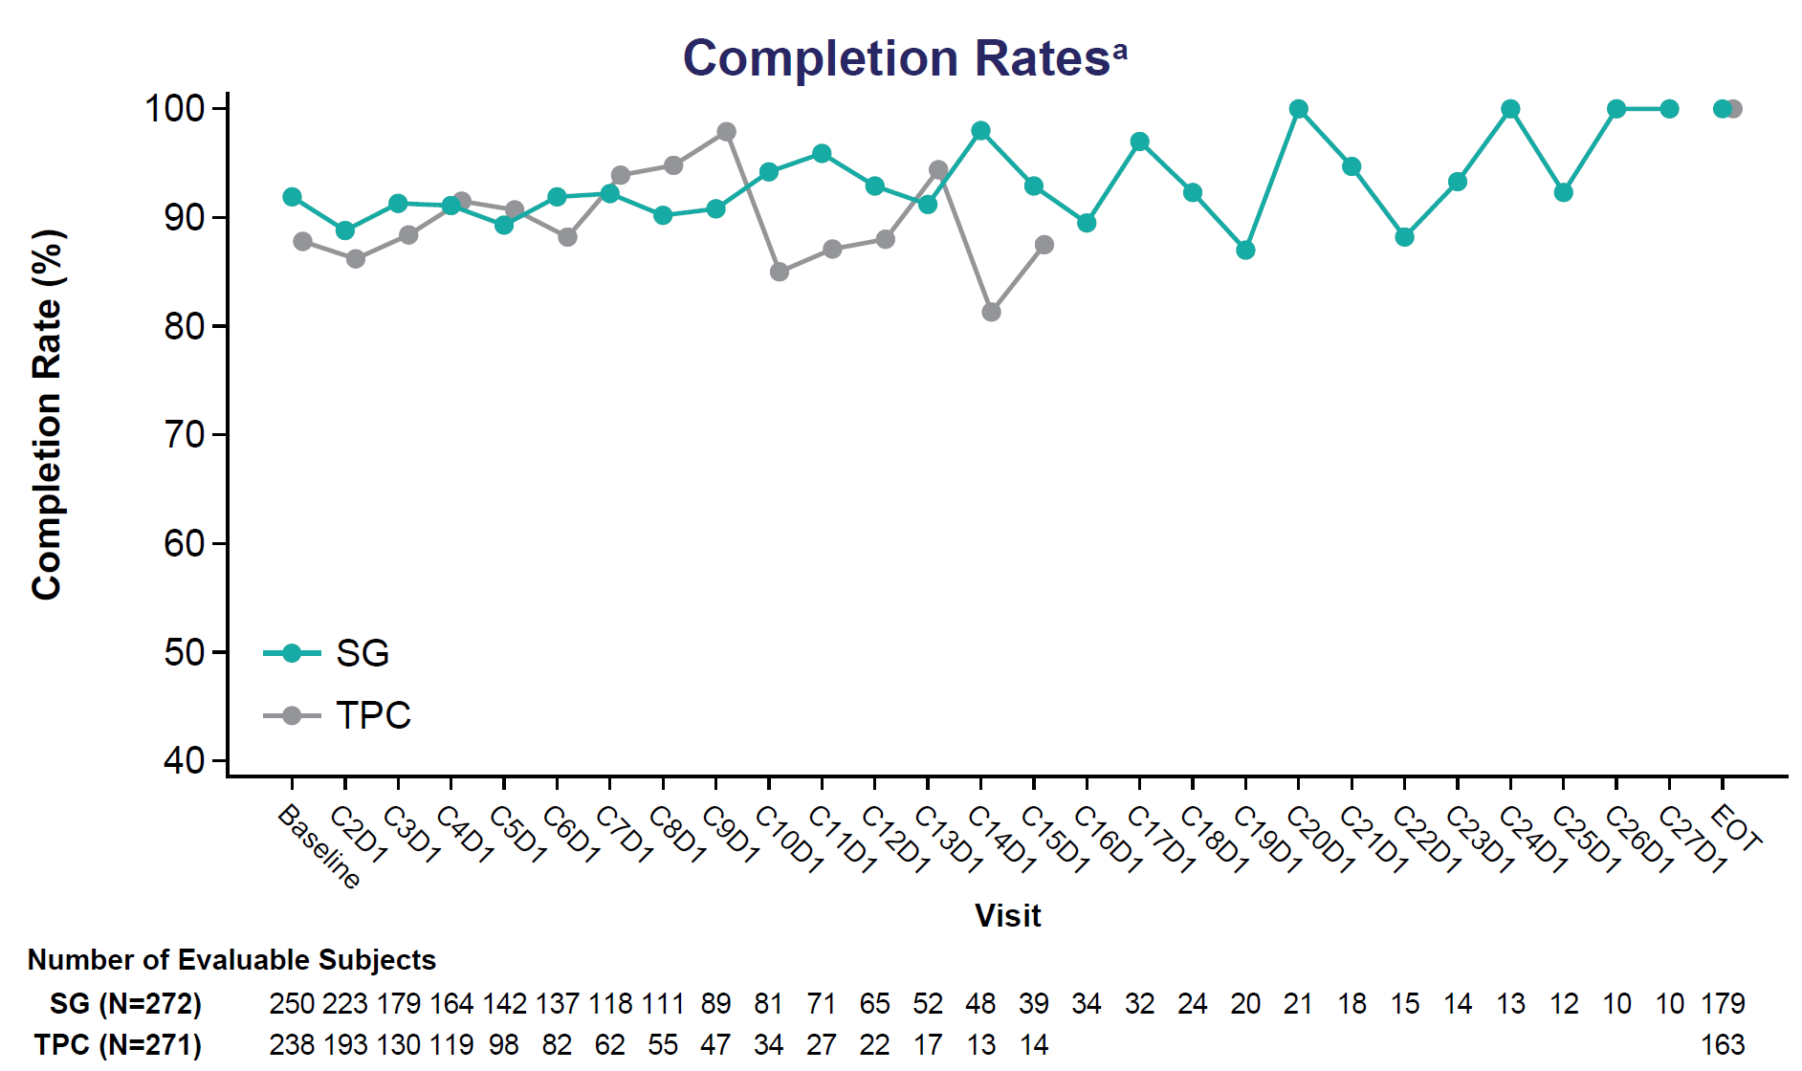
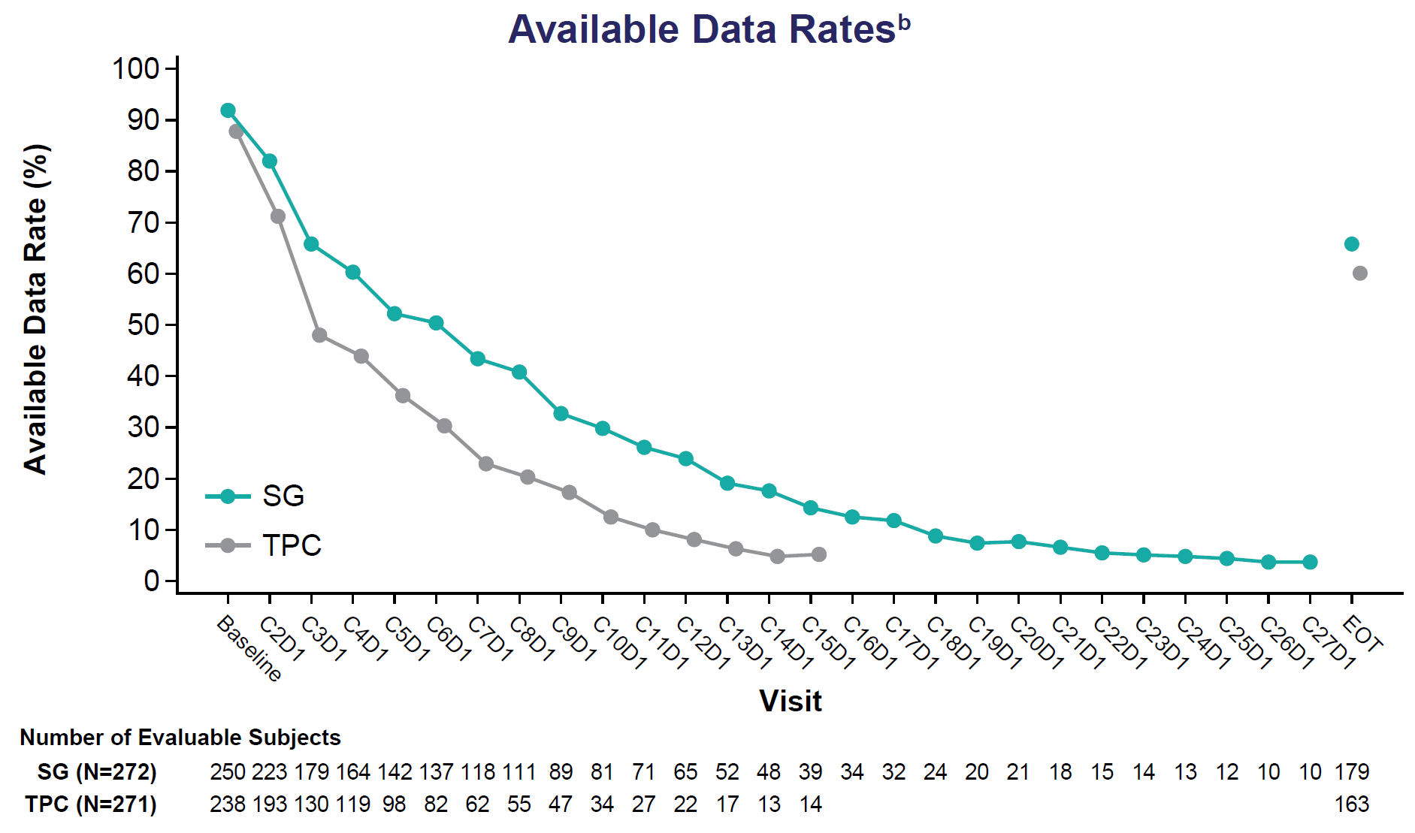
Results Completion and Available Data Rates for the EORTC QLQ-C30 by Visit and Treatment Groups
The EORTC QLQ-C30 completion rate was comparable between SG and TPC and available data rates decreased over time in both treatment groups
The completion rates and available data rates for the EQ-5D-5L and PRO-CTCAE were generally similar to that observed for EORTC QLQ-C30
ªThe denominator for C2D1, C3D1 etc. visits was estimated based on the number of subjects in the ITT population who had at least 1 dose at or after Cycle 2, 3, etc. or had a valid assessment at that visit. The denominator for the EOT visit was estimated based on the number of ITT population subjects with a treatment discontinuation date within 4 weeks after the date of last treatment, or with an HRQoL-evaluable assessment at the EOT visit. ^{b}Fixed denominators were used, with the denominator for each visit estimated based on the number of subjects in the ITT population per treatment arm. C, cycle; D, day; EORTC QLQ-C30, European Organization for Research and Treatment of Cancer Quality-of-Life Core 30 questionnaire; EOT, end of treatment; HRQoL, health-related quality of life; ITT, intention-to-treat; SG, sacituzumab govitecan; TPC, treatment of physician’s choice.
1. Marmé F, et al. Presented at SABCS 2022 (abstract ID P4-07-65). Effect of Sacituzumab Govitecan vs Chemotherapy in HR+/HER2- Metastatic Breast Cancer: Patient-Reported Outcomes From the TROPiCS-02 Trial

Slide 12
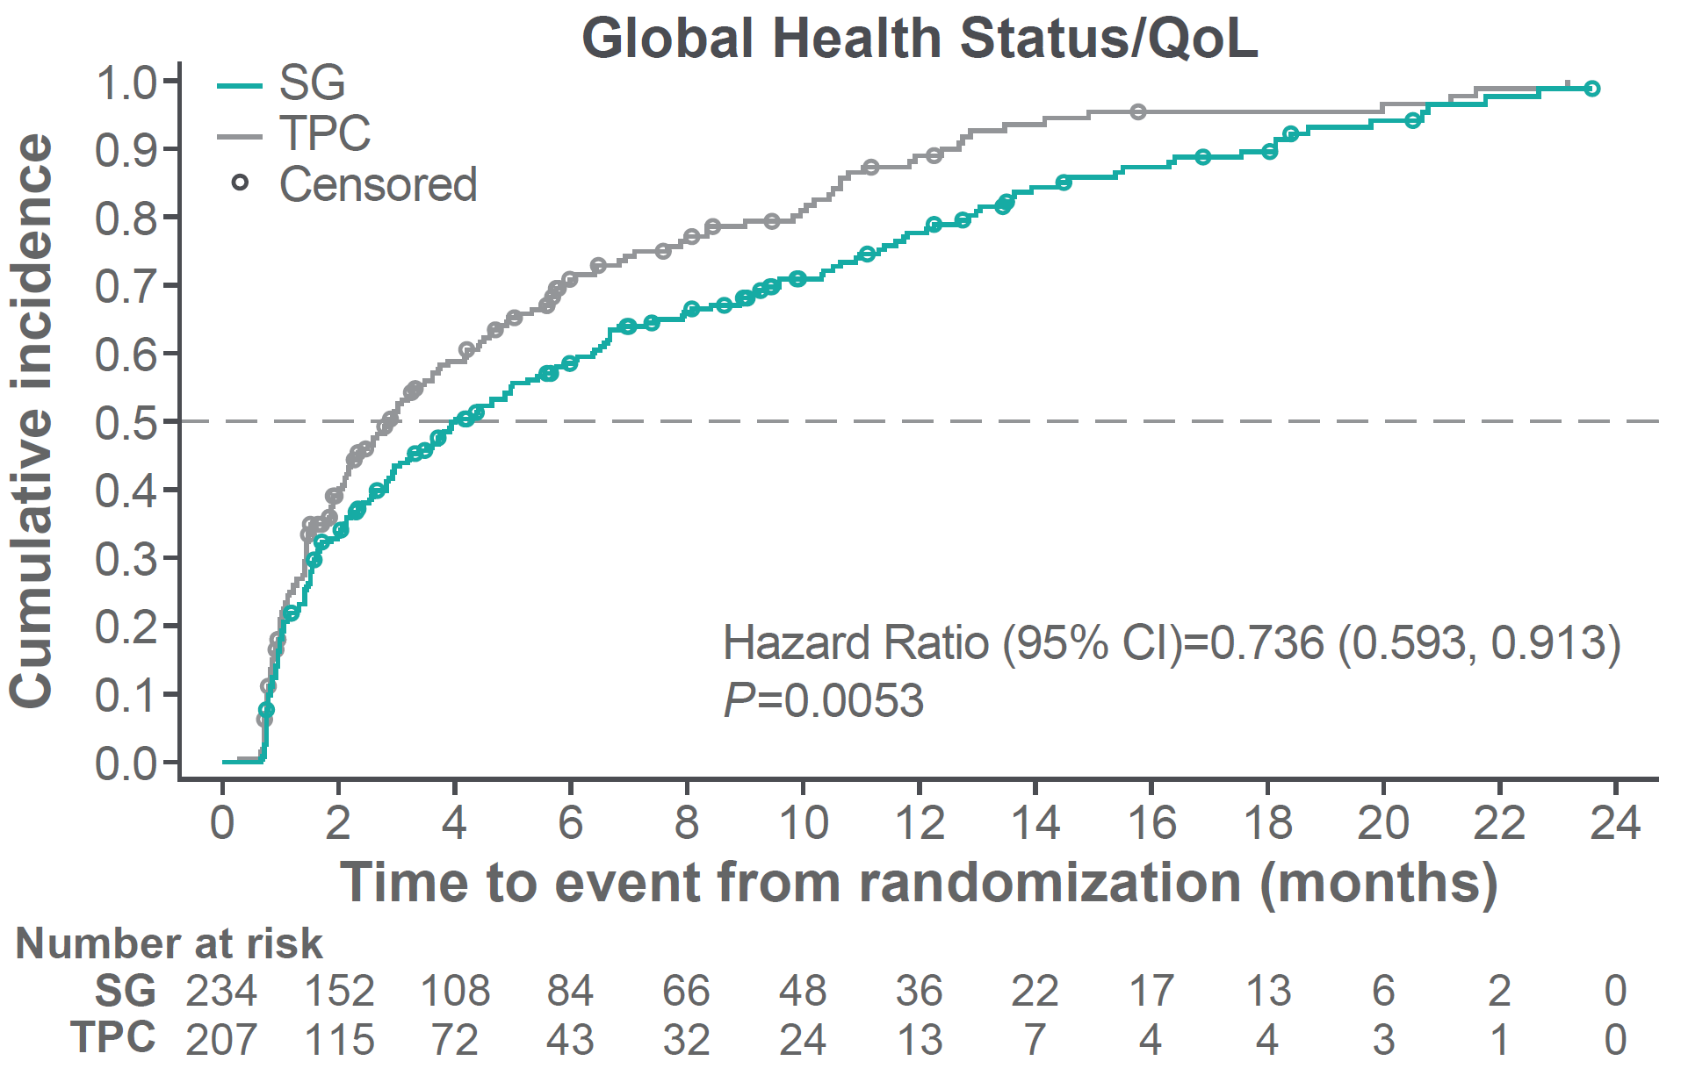
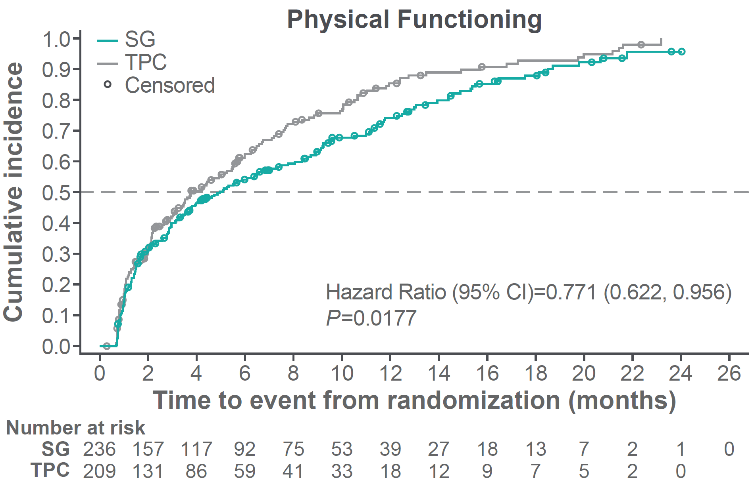
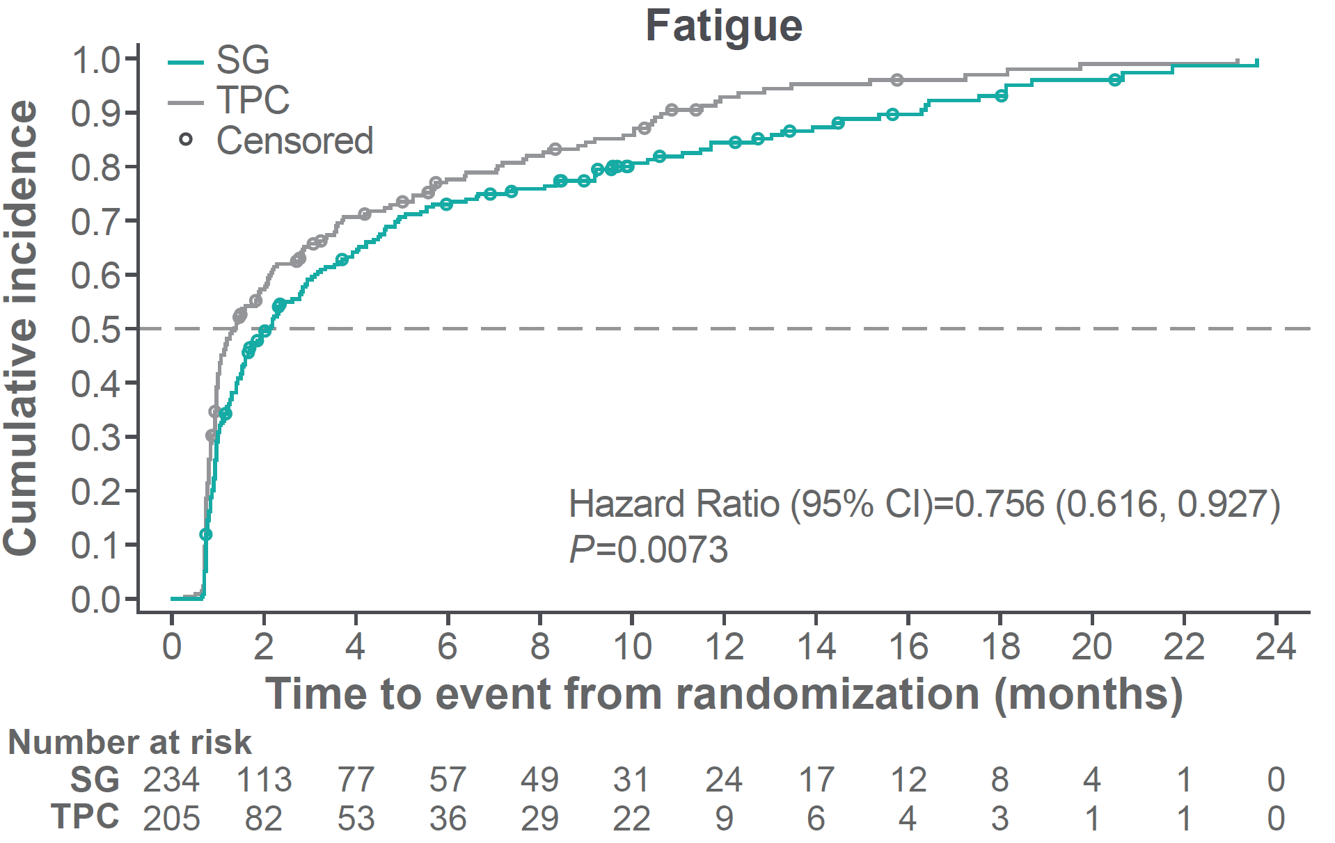
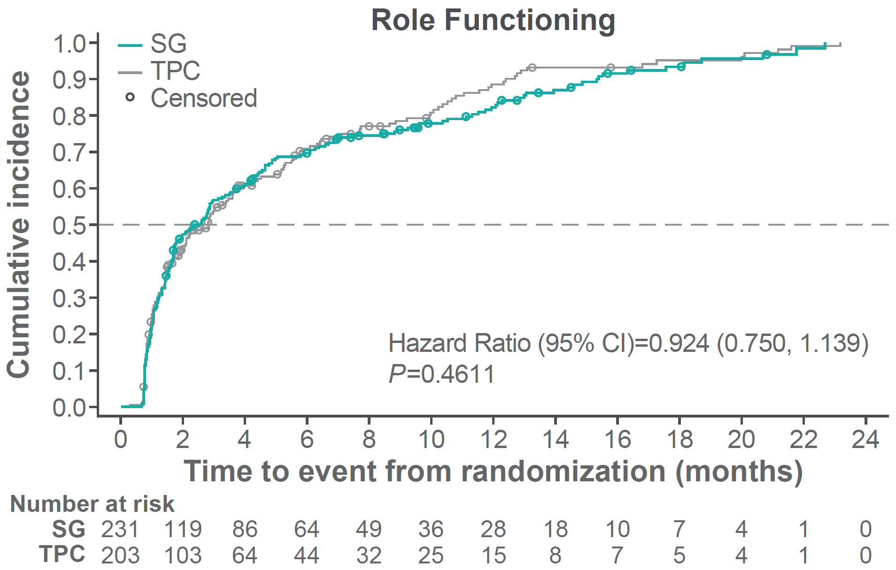
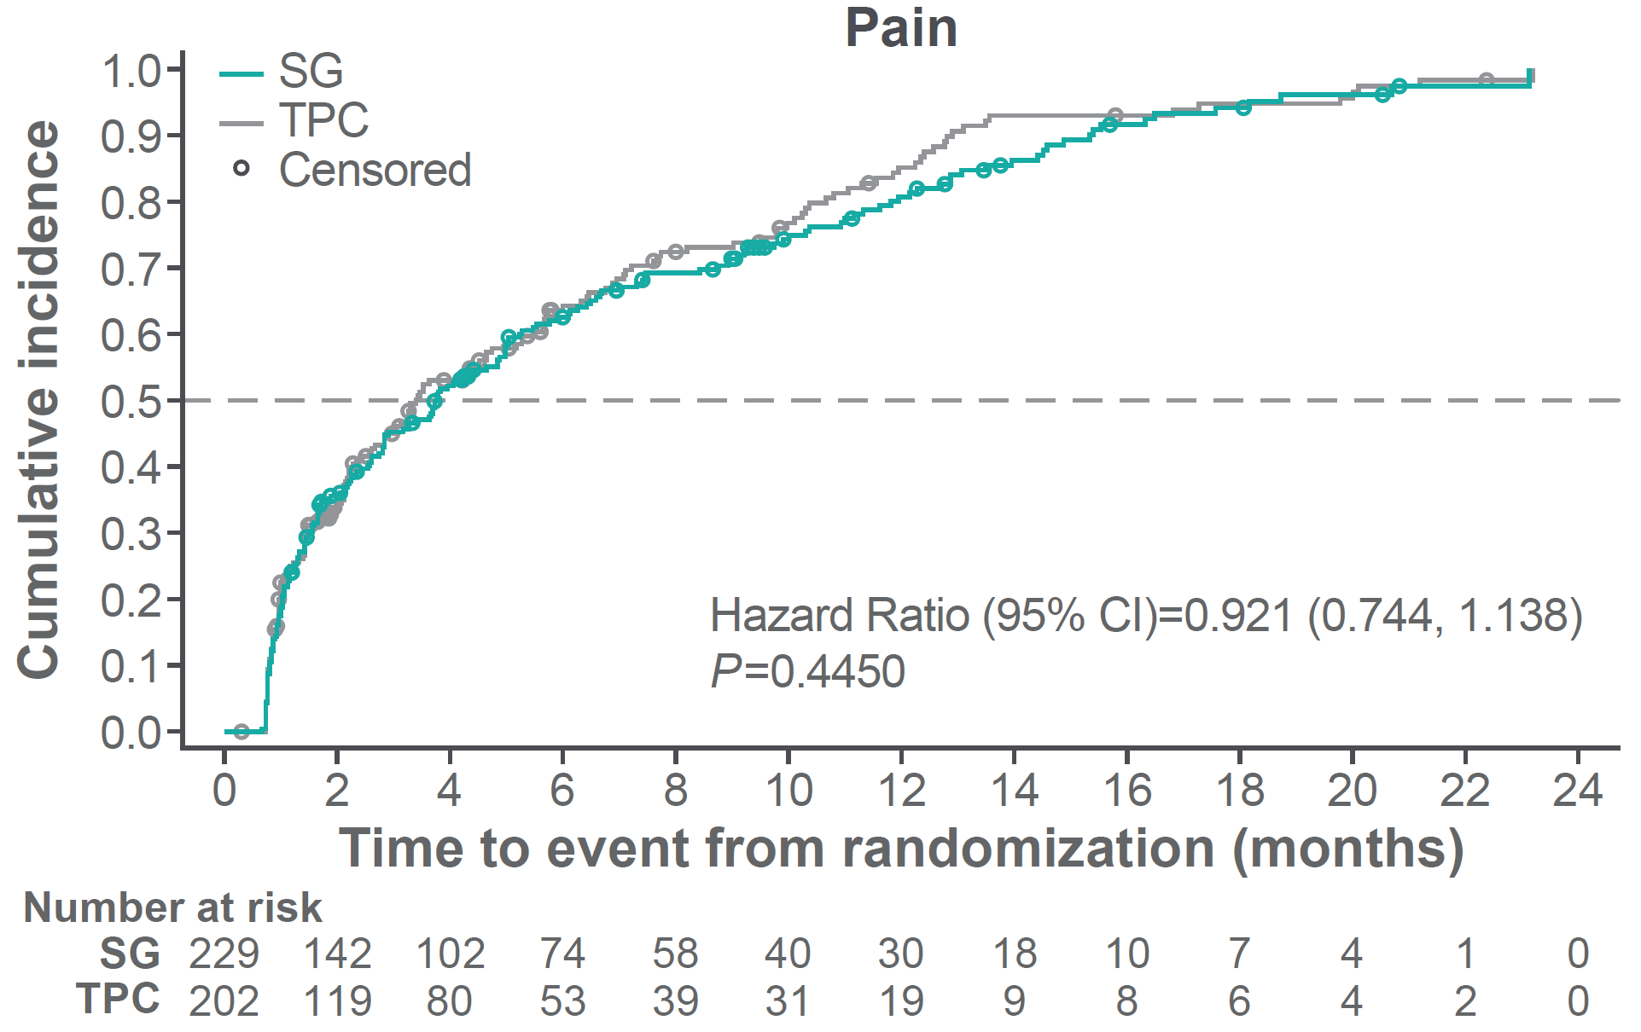
Results Time to First HRQoL Worsening or Death in EORTC QLQ-C30 Primary Domains of Interest
The Efron method was used to handle ties. EORTC QLQ-C30, European Organization for Research and Treatment of Cancer Quality of Life Questionnaire Core 30; EQ-5D-5L, EuroQoL 5 Dimension 5 Level; HRQOL, health-related quality of life; ITT, intention-to-treat; QoL, quality of life; SG, sacituzumab govitecan; TPC, treatment of physician’s choice.
1. Marmé F, et al. Presented at SABCS 2022 (abstract ID P4-07-65). Effect of Sacituzumab Govitecan vs Chemotherapy in HR+/HER2- Metastatic Breast Cancer: Patient-Reported Outcomes From the TROPiCS-02 Trial

Slide 13
Results Time to First Clinically Meaningful Deterioration of PRO Scores
 | Median Time to First Clinically Meaningful Deteriorationª (Months) | TPC (n=271) | Hazard Ratio | 95% Confidence Interval
 | SG (n=236) | TPC (n=210) | Hazard Ratio | 95% Confidence Interval
EORTC QLQ-C30ª (N=446)
Global health status/QoL | 4.0 | 2.9 | 0.74 | 0.59-0.91**
Physical functioning | 5.0 | 3.7 | 0.77 | 0.62-0.96*
Role functioning | 2.6 | 2.8 | 0.92 | 0.75-1.14
Emotional functioning | 7.4 | 5.0 | 0.67 | 0.54-0.84**
Cognitive functioning | 4.6 | 4.6 | 0.89 | 0.72-1.10
Social functioning | 2.9 | 3.6 | 0.89 | 0.72-1.10
Fatigue | 2.1 | 1.4 | 0.76 | 0.62-0.93**
Nausea and vomiting | 2.2 | 4.6 | 1.13 | 0.91-1.39
Pain | 3.7 | 3.4 | 0.92 | 0.74-1.14
Dyspnea | 5.7 | 4.4 | 0.75 | 0.61-0.94*
Insomnia | 6.2 | 4.4 | 0.77 | 0.62-0.97*
Appetite loss | 3.6 | 4.5 | 0.98 | 0.78-1.22
Constipation | 3.8 | 4.9 | 1.07 | 0.86-1.33
Diarrhea | 2.2 | 5.8 | 1.54 | 1.24-1.91**
Financial difficulties | 9.2 | 6.8 | 0.79 | 0.62-0.99*
Summary score | 5.0 | 5.3 | 0.92 | 0.74-1.15
 | SG (n=238) | TPC (n=207) | Hazard Ratio | 95% Confidence Interval
EQ-5D-5L (N=445), health utility index | 5.3 | 5.1 | 0.94 | 0.75-1.17
EQ-VAS | 4.4 | 3.5 | 0.79 | 0.64-0.98*
ªFor the EORTC QLQ-C30 function and global health status/QoL domains, patients with a BL score ≥10 and for symptom scales, patients with a BL score ≤90 were included. *P<0.05; **P<0.01.
BL, baseline; EORTC QLQ-C30, European Organization for Research and Treatment of Cancer Quality of Life Questionnaire Core 30; EQ-5D-5L, EuroQoL 5 Dimension 5 Level; PRO, patient-reported outcomes; QoL, quality of life; SG, sacituzumab govitecan; TPC, treatment of physician’s choice; TTD, time to deterioration; VAS, visual analog scale.
1. Marmé F, et al. Presented at SABCS 2022 (abstract ID P4-07-65). Effect of Sacituzumab Govitecan vs Chemotherapy in HR+/HER2- Metastatic Breast Cancer: Patient-Reported Outcomes From the TROPiCS-02 Trial
13

Slide 14
Results Figure 6. Distribution of Change in Response With Any Worsening to 3 or 4 During Treatment From Baseline for PRO-CTCAE
The denominator for the percentage calculation in each response category is based on the number of safety population subjects with non-missing scores at both baseline and at least one postbaseline visit (including the EOT visit). EOT, end of treatment; ITT, intention-to-treat; PRO-CTCAE, Patient-Reported Outcome-Common Terminology Criteria for Adverse Events; SG, sacituzumab govitecan; TPC, treatment physician’s choice.
1. Marmé F, et al. Presented at SABCS 2022 (abstract ID P4-07-65). Effect of Sacituzumab Govitecan vs Chemotherapy in HR+/HER2- Metastatic Breast Cancer: Patient-Reported Outcomes From the TROPiCS-02 Trial
14

Slide 15
Conclusions
Except for amount of hair loss and diarrhea frequency, SG significantly delayed worsening of overall QoL, physical and emotional functioning, and symptoms like fatigue, dyspnea, and insomnia
Overall, our findings suggest that SG has more favorable effects on PROs compared with TPC in patients with HR+/HER2- mBC
SG demonstrated a benefit in PROs for patients with pretreated HR+/HER2- mBC and coupled with a statistically significant and clinically meaningful PFS and OS benefit, these data support the use of SG as an important treatment option for this population
1. Marmé F, et al. Presented at SABCS 2022 (abstract ID P4-07-65). Effect of Sacituzumab Govitecan vs Chemotherapy in HR+/HER2- Metastatic Breast Cancer: Patient-Reported Outcomes From the TROPiCS-02 Trial

Slide 16
Trodelvy▼ (sacituzumab govitecan)
▼Detta läkemedel är föremål för utökad övervakning.
Trodelvy® (sacituzumabgovitekan) 200 mg pulver till koncentrat till infusionsvätska, lösning. Antineoplastiska medel. Antikropp-läkemedelskonjugat. Rx., EF. Indikationer: Monoterapi vid behandling av vuxna patienter med icke-resektabel eller metastaserad, trippelnegativ bröstcancer (mTNBC) som tidigare har fått två eller flera systemiska behandlingar, varav minst en av dem mot avancerad sjukdom. Monoterapi vid behandling av vuxna patienter med icke-resektabel eller metastaserad hormonreceptor (HR)-positiv, HER2-negativ bröstcancer som har fått endokrinbaserad behandling och minst två ytterligare systemiska behandlingar för avancerad sjukdom. Kontraindikationer: Överkänslighet mot sacituzumabgovitekan eller hjälpämne. Varningar och försiktighet: Kan orsaka svår eller livshotande neutropeni. Det rekommenderas att patienternas blodvärden övervakas under behandlingen. Ska inte administreras om det absoluta antalet neutrofiler understiger 1 500/mm³ på dag 1 under någon cykel eller om antalet neutrofiler understiger 1 000/mm³ på dag 8 under någon cykel eller vid neutropen feber. Kan orsaka svår diarré. Ska inte administreras vid diarré av grad 3–4. Kan orsaka svår eller livshotande överkänslighet. Premedicinering rekommenderas och noggrann observation med avseende på infusionsrelaterade reaktioner. För att förebygga cytostatikainducerat illamående och kräkningar rekommenderas förebyggande behandling med antiemetika. Patienten måste övervakas under varje infusion och i minst 30 minuter efter varje infusion. Patienter med känd reducerad UGT1A1-aktivitet ska övervakas noga med avseende på biverkningar. Gravida kvinnor och fertila kvinnor ska informeras om den potentiella risken för foster. Innehåller natrium, ska beaktas i relation till patientens totala natriumintag. Innehavare av marknadsföringstillståndet: Gilead Sciences Ireland UC För information: Kontakta Gilead Sciences Sweden AB, + 46 (0) 8 5057 1849. För fullständig information om dosering, varningar och försiktighet, interaktioner och biverkningar samt aktuell information om förpackningar och priser se www.fass.se Baserad på produktresumé: 07/2023
SE-TRO-0246 Date of preparation April 2025

